Slide 1
Before our Presentation…
Please have your microphones muted during the presentation.
Our session is being recorded. Please turn off your camera if you do not want to appear on the recording.
If you have questions during the session, write them in the chat and the moderator will address them when appropriate during the presentation.

Slide 2
Diet Culture: Recognize it! Reject it! Revise the narrative!
OFSHEEA Guidance Document
Learning and Teaching About Body Acceptance, Weight Bias and Food Neutrality

Slide 3
Agenda: March 28, 2022 4:00 – 5:30pm
Welcome and Land Acknowledgement
Introductions
Minds On Activity
Our Goals
Setting Ground Rules
Taking a Closer Look
Our Partners – NEDIC, Nutrition Connections, Dietitians 4 Teachers
Consolidation and Gathering Feedback
Dates for next sessions:
May 2 – Reject It!
May 30 - Revise the Narrative!

Slide 4
Thank You!

Slide 5
PAUSE AND Reflect
To what extent does diet culture impact your students’ daily life?
Remember, this could be at school, home or in the community.
Please put your ideas into the chat box, but DO NOT hit SEND until I tell you!

Slide 6
Introduction
The Ontario Family Studies Home Economics Educators’ Association (OFSHEEA) facilitates professional development and personal growth of educators to promote quality Family Studies programs in Ontario. This guidance documents aims to support teachers with current information for teaching about and dismantling diet culture.
OFSHEEA understands that nutrition and social science knowledge is dynamic, and that curriculum can sometimes struggle to keep up with the latest findings. We aware of how popular media may sometimes portray nutrition science in a skewed way, and how associated health topics may often be misinterpreted. As social media continues to reinforce pervasive diet behaviours and diet culture, our classrooms must strive to be places where conversations about food and eating are meaningful for students, rather than rooms that teach nutrition and health concepts with short-sighted curriculum expectations in mind.
The resources found in this document are relevant to the date of publication.

Slide 7
Our Goals
Recognize and value our individual learning journeys
Address a growing need in our classrooms
“Updating” our curriculum to reflect an ever-changing knowledge and teaching practices in our subject area

Slide 8
Ground Rules
We will focus our work today on our classrooms and the students we work with each day.
Adult conversations - not meant for your classroom tomorrow.
Empowering teachers.
Positive intentions and want what is best for our students.

Slide 9
Ground Rules (continued)
Diet culture reflects differently for each of us. We need to honour each other’s experiences.
We aren’t going to invite debate about whether or not there is an obesity epidemic in our society.
We aren’t going to debate one style of eating over another – one isn’t better than the other.
We will focus on the messages of Canada’s Food Guide.

Slide 10
Diet Culture: Recognize it! Reject it! Revise the narrative!
OFSHEEA Guidance Document
Learning and Teaching About Body Acceptance, Weight Bias and Food Neutrality

Slide 11
My 3 [year old] said goodnight to all of us tonight. And then in the dark I heard her little voice say, “Goodnight myself. I love you. [pause] I love you too.” Don’t let anyone take that from you, little one (Nordbak, 2022).
Nordbak, J. [@JennyNordbak]. (2022, February 3). Don’t let anyone take that from you, little one [Tweet]. Twitter. https://twitter.com/JennyNordbak/status/1489146785075326981

Slide 12
The influence of diet culture is an elusive problem, and it permeates all aspects of living – what we eat, what we wear, what we buy, what we think, what we watch, how we schedule our time, and how we move our bodies. To tackle diet culture in a meaningful way requires a multi-faceted approach to overhauling our society’s weight-loss obsession.

Slide 13
Did you know that starting at age five, many girls begin to develop self-limiting beliefs and think they're not as smart and capable as boys. This issue is called the Dream Gap. They stop believing that they can be anything they want to be (Mattel, 2022).
In your opinion…
Does diet culture contribute to the Dream Gap?
Mattel. (2022). What is the dream gap? https://shop.mattel.com/pages/barbie-dream-gap

Slide 14
The aim of this document
OFSHEEA’s goal with this guidance document is to begin unravelling diet culture by recognizing its associated behaviours
in ourselves,
in our classrooms and workplaces, and
in the broad community.
It is our hope that as an educator you will welcome learning more about, and recognizing, weight bias and diet culture, and that with this new knowledge, you will take the opportunity to reject diet culture and pass along how to reject it to your students. In addition, we anticipate you will become better versed at revising the narrative on diet culture in your classroom and workplace by landing on appropriate resources that use food neutral language and focus on strategies for enjoying food as nourishment and celebration.
Welcome to Diet Culture: Recognize it! Reject it! Revise the narrative!

Slide 15
The Document at a glance
MODULE 1: Recognize it!
MODULE 2: Reject it!
MODULE 3: Revise the Narrative
Deciphering and learning to see potential weight bias in ourselves.
Recognizing the words and activities that accentuate or promote diet culture.
Learning how to reject diet culture and pass on these strategies to our students.
Learning to suss out competent resources – what to look for and what to reject.
A Guide to Terminology, Usage Tips and Definitions
Suggested resource connections.
Where to link for further information and training.
Why?
Who?
How?
What?
Where?
Each module includes a comprehensive reference list and a glossary of terms.

Slide 16
Using the Guide
Each module includes one or more learning goals.
What We Know about the topic is presented.
Activities for Further Learning are suggested.
Key concepts or terms are redefined with CAN and CAUTION information for classroom use.
Adult Activity Ideas are offered for possible peer/colleague mentoring.
EACH Module is colour coded.

Slide 17
Module 1: Recognize it!
Deciphering and learning to see potential weight bias in ourselves.
Learning Goal: Educators will recognize weight bias within themselves so they can better understand the influence of our society’s dominant attitudes on multiple audiences. As adults we are not immune to the influence of our family, peers, and popular media.

Slide 18
What We Know…
Weight bias refers to negative attitudes towards, and beliefs about, others because of their weight.
To fully engage in supporting a new approach to nutrition education it may be necessary to consider unconscious and implicit bias to a variety of societal beliefs about lean bodies.
The idea that thinner bodies are more disciplined, healthier, and more worthy of attention is a common bias.

Slide 19
Self-Assess Your Own Weight Bias
By learning to recognize personal bias we can engage in dialogue, and implement strategies to support safe, competent, and ethical teaching.
Psychologists at Harvard, the University of Virginia and the University of Washington created "Project Implicit" to develop Hidden Bias Tests—called Implicit Association Tests, or IATs, in the academic world—to measure unconscious bias.
Learn about your own implicit bias by trying Harvard’s Implicit Bias Test. You will need to click “I wish to proceed” to take the test. This test is part of Harvard’s ongoing research regarding implicit bias topics. Read more about the ongoing research here.
Consider Assessing Your Size Attitude developed by Susan Kano in Making Peace with Food (Kano, 1989).

Slide 20
Putting Implicit Bias Into Context
Most people belong to at least one dominant identity group. When your identity is dominant, it’s easy to think of your experience as universal and to overlook or downplay the experiences of others (Teaching Tolerance, 2019).
Thinking carefully about your own body and weight identity and the ways it has shaped your experience and influences your assumptions – including assumptions about your students – can help you recognize biases before you engage with critical topics in your classroom.

Slide 21
Learn about your own potential for implicit weight bias
Reflect on the answers to the following questions:
What messages did I learn about weight/exercise/eating when growing up?
Where have I received information about health, weight, and bodies? Are they reputable sources of information? How do I know they are reputable?
How does my membership in a specific identity group (team, ethnicity, age, race, etc.) affect my thoughts about health, weight, and bodies?
What messages – both implicit and explicit about weight/diet culture do I convey to my students?
Do I make assumptions about people based on their size or weight?
Am I more likely to be friends with people of certain body types?
What does a person’s health say about their worth as a human being?

Slide 22
Usage Guidelines:
Having an implicit bias means subconsciously treating someone or an entire group differently; it is often based on preconceived notions or understandings of the world. It can cause you to assume the thoughts and actions of others, often holding yourself to a higher standard than them.
Can:
There is no specific route to launch individuals in society out of any body-based beliefs they have developed. The route does require relearning on how to see humanity reflected in those around us – regardless of their bodies. To work on releasing bias requires the discipline to hold ourselves to new standards (Human Parts, 2020).
Caution:
If you worry that this is something you are guilty of, it is important that you realize that you’ve already come a long way in making the effort to recognize it!
Continue to notice the bias and bring it into your awareness so that you can actively manage it. It’s exhausting and important work!”
IMPLICIT BIAS

Slide 24
Understanding Weight Bias Weight Bias Lightbulb Activity – for Adults
In this activity you will: | Participants identify and explain weight stereotyping they may have experienced in their lives
Material: | Prepare large cards shaped like light bulbs for the participants to write on or prepare a jam board. | Duration: | 10 minutes
Activity Description 1. Discuss what a safe and brave space is and how we can create and keep a safe space in the group. 2. Introduce the idea of a weight bias lightbulb moment. A “weight bias lightbulb moment” is a time you became aware of being treated differently (better/worse) because of your weight. For example: not being chosen first for a sports activity, or being told you would have to sit in a different seat not being able to find clothing that fits in a trendy clothing shop you were assumed to be physically active/fit because you are thin. It could be anything from the activities you were allowed to participate in, having different rules applied to an activity because of size, to feeling uncomfortable in a certain situation because of your weight. 3. Get into small groups and share your weight bias lightbulb moments. 4. Write down your answers on a large piece of card shaped like a lightbulb then hang them up on a string for the other groups to read. 5. Go through the other groups’ answers and identify similar answers. How was the ‘weight bias lightbulb moment’ sharing? Did you have moments in common? How do these weight bias differences affect our everyday lives? What can we do about the issues we identified?

Slide 25
For Further Learning…
Read up on bias in the Ontario Physical and Health Educator Association (OPHEA’s) Approaches to Teaching Healthy Living - A Guide for Secondary Educators. Information on bias is on pages 13-14.
Consider the route to learning about unravelling your implicit weight bias or anti-fat bias using the Human Parts suggestions found here.

Slide 26
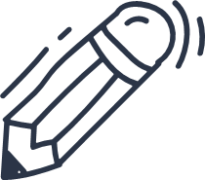
References
Human Parts. (2020, March 2). 7 Ways to Uproot Your Anti-Fat Bias.
Medium. https://humanparts.medium.com/7-ways-to-uproot-your-anti-fat-bias-54f01d76ec3b
Kano, S. (1989). Making Peace With Food: Freeing Yourself from the Diet/Weight Obsession. Harper Collins Publishers Inc.

Slide 27
Module 1: Recognize it!
Recognizing the words and activities that accentuate or promote diet culture.
Goal: Educators will recognize how words, phrases and teaching strategies contribute to diet culture so they can begin to change the dialogue and teaching pedagogy.

Slide 28
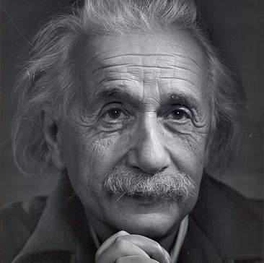
“We can not solve our problems with the same level of thinking that created them.”
~ Albert Einsten
This Photo by Unknown Author is licensed under CC BY-NC-ND

Slide 29
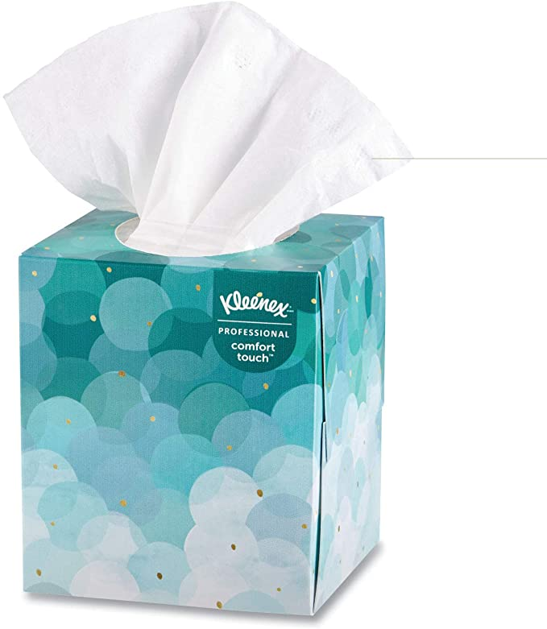
Getting Started: Meeting people “where they are”.
What does handing a tissue mean to someone when they are crying?
A lesson of perspective.
Recognizing the need to recognize.
King’s University College, Western University
Course: Communication with the Dying and Bereaved
Leslie Misurak, B.A. Certificate in Palliative Care & Thanatology.

Slide 30
First Do No Harm
Jennifer O’dea in her School-Based Interventions to Prevent Eating (2000) writes “In order to develop effective and sustainable eating disorder prevention programs we must first exclude those approaches and practices which have been proven to be ineffective.”
Information-based strategies in school classroom settings that have focused on providing students with information about eating disorders, facts about the potential dangers of dieting, nutrition information, and analysis of the social construction of body image ideals and cultural stereotypes of the perfect body have fallen prey to iatrogenesis.
From the Greek word iatros, iatrogenesis means harm brought forth by a healer or any unintended adverse patient outcome because of a health care intervention, not considered the natural course of the illness or injury.

Slide 31
Our words and actions have long-lasting effects
Research by clinicians and researchers at the Hospital for Sick Children and Children’s Hospital of Eastern Ontario (Pinhas, L., McVey, G., Walker, K. S., Norris, M., Katzman, D., & Collier, S., 2013) exposes how healthy eating and weight initiatives, that have been incorporated into many schools to combat the “obesity” problem, can trigger the adoption of unhealthy behaviours for some students.
It is a heavy burden to unload that despite good intentions, the unanticipated consequences of how we teach our curriculum is having a profound negative effect on our youth. As Family Studies educators we need to step up and realize how to reduce the risk of harm to our students, ourselves, and the future society we are educating.
Our students experience diet culture in our classrooms and schools unless we make a conscious effort to eliminate it. Have you been a purveyor of diet culture? Continue reading to learn more.

Slide 32
Deepening Our Understanding

Slide 33
Disordered habits that have been normalized by society
Disordered habit | Seen it? ☑
Measuring or weighing food
Talking about getting healthy with an emphasis on changing weight or shape
Having “rules” for eating or a “right” way of eating
Relying on gadgets or apps to tell us what and how much to eat
“Tracking” food and beverages consumed
Intentionally ignoring hunger cues
Bonding over food rules, diets and restricted eating
Using moralizing language to describe food such as “good, bad, junk, clean"
Revised from resources by NEDIC for Eating Disorder Awareness Week 2022 and Brooke Bulloch, RD, Saskatchewan

Slide 34
Do you talk about food in moral terms?
Words that place a moral value on certain foods tend to give us direction on what to eat
This neglects the process of looking inward to consider what we may want to eat or perhaps educating ourselves on what nutrients our bodies actually need.
“They really encourage behaviors or thought processes that make people distrust their own body's response to food, and offer them alternatives to ignore hunger cues,” explains National Eating Disorder Association (NEDA) director of programs Lauren Smolar (Schumer, 2021)

Slide 35
Usage Guidelines:
Weight-related microaggressions are subtle, perhaps unintentional communications of weight bias. They may be verbal, but they may also be non-verbal. These multiple small, or apparently inconsequential, reminders of the supposed devalued status are endemic and often overlooked.
Can:
Make it a habit not to use language that focuses on your own or others’ weight. We have no idea what someone is going through. When we stop using this kind of language we create an environment in which people of all sizes can coexist without a sense of weight surveillance.
Pay attention to the non-verbal actions that inhibit comfort of diverse bodies. Do you offer sports or movement clubs at school for all bodies? Does school spirit-wear or SWAG come in a variety of sizes?
Caution:
Using the phrase, “Wow, have you lost weight?”. Recognize the potential impact of the statement. It has a series of implications associated with it. The statement assumes that weight loss is always positive, no matter how it is achieved. This statement may seem innocuous, but it actually creates an uncomfortable sense that people are being surveillant and judging a body.
MICROAGGRESSION

Slide 36
Understanding Body Inclusivity Do the mall and the Instagram match? Activity for Adults
In this activity you will: | Participants identify and explain lack of body inclusivity they may have experienced in their lives
Activity Description Discuss what a mall social environment might look like on a Saturday afternoon. Who might be at the mall and what type of body diversity might be seen? Introduce the idea of a matching moment. A “matching moment” is an opportunity to make legitimate connections between two pieces of information. For example: Having basil, tomatoes and garlic and wondering what type of cuisine might work with those ingredients. 3. Get into small groups and share your matching momemnts. 4. Now consider the matching potential of the diversity at the mall. Does this diversity match in diversity to the accounts that you follow on Instagram? 5. Go through the other groups’ answers and identify similar answers. How was the ‘body inclusivity’ apparent or not existent? What can we do about the issues we identified?

Slide 37
Usage Guidelines:
One of the more harmful effects of people being labeled "obese" is often the prescribed recommendation to lose weight. Attempts to lose weight have been associated with lean tissue loss, a higher risk of preoccupation with food and eating disorders, and other psychological consequences. Often people use “diets” in an effort to lose weight despite newer research showing dieting can predict weight gain (National Eating Disorder Information Centre, 2022).
Can:
A person's weight may be influenced by numerous contributors beyond diet, physical activity, and genetics. Therefore it should not be assumed a person labeled "obese" is necessarily unhealthy.
Caution:
If or when the terms “overweight”, “obese”, and “obesity” must be used, it is advised that they be put in quotation marks, as many people consider them stigmatizing.
Recognize that among the medical profession (and other health professions), “obesity” management is still widely endorsed and practiced, despite recent efforts and research suggesting efforts to combat diet culture may be a better approach.
“OBESITY” or “OBESE”

Slide 38
Homework and Further Reading
The following organizations may aid teachers in furthering their understanding of how to effectively communicate messages about food, eating and bodies.
Nutrition Connections. Look for workshops, toolkits, and podcasts. Look forward to Food Matters: Using Language that Supports Children and Youth!
Book List:
Fearing the Black Body: The Racial Origins of Fat Phobia by Sabrina Strings, 2019.

Slide 39
References
National Eating Disorder Information Centre. 2022. Additional Definitions:
Obesity. https://nedic.ca/eating-disorders-treatment/
O'dea, Jennifer (2000) 'School-Based Interventions to Prevent Eating Problems: First Do No Harm', Eating Disorders, 8:2, 123 – 130. http://dx.doi.org/10.1080/10640260008251219
Pinhas, L., McVey, G., Walker, K. S., Norris, M., Katzman, D., & Collier, S. (2013). Trading health
for a healthy weight: the uncharted side of healthy weights initiatives. Eating disorders, 21(2), 109–116. https://doi.org/10.1080/10640266.2013.761082
Schumer, L. (2021, June 10). Why I Banned Words Like "Guilt Free" and "Cheat Day" From My Vocabulary. GoodHousekeeping.
https://www.goodhousekeeping.com/health/diet-nutrition/a36465849/toxic-diet-culture-words-phrases/

Slide 40
Recognize It!
These initial steps in learning about diet culture, weight bias, fatphobia and triggering language serve as a starting point for Family Studies teachers to recognize the profound influence of diet culture in our own and in societal behaviours.
To allow ourselves and our students to live and adopt body inclusivity, eating joyfully and speaking freely about food without judgement or condemnation we encourage continued further reading of the Recognize it! Guide and participation in our companion guideline sessions Reject It! and Revise the Narrative! in May 2022.

Slide 41
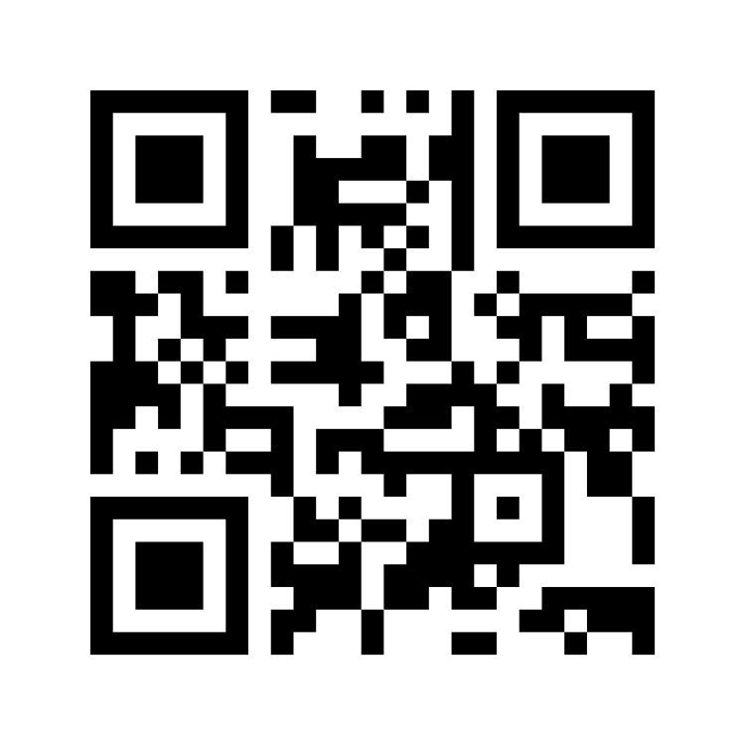
When I hear the term DIET CULTURE I think of these words/phrases …
https://www.menti.com/jkykedi13t

Slide 43
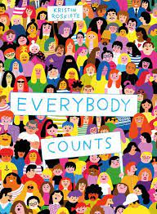
Consolidation
What we have been teaching in our classrooms WAS consistent with evidence-based guidelines, but NOW we need to empower teachers to recognize diet culture and model body inclusivity in the classroom – by rejecting behaviours and systems and revising the narrative.

Slide 44
Next Steps
What are you expecting us to talk about today?
What do you still need?
https://jamboard.google.com/d/1eqiiXBHDDVOZ-IO9Wm5c1cW4dnLu0Wf15bhsBvcFWLs/edit?usp=sharing
Future sessions:
May 2 - Reject It!
May 30 - Revise the Narrative!
Feedback survey link

Slide 45
SUPPORT FOR INDIVIDUALS EXPERIENCING EATING- OR WEIGHT-RELATED DISTRESS
Reflecting on and discussing weight bias and diet culture may arouse discomfort, or even distress.
The National Eating Disorder Information Centre (NEDIC) operates an anonymous toll-free helpline and instant chatline through which any individual experiencing eating- or weight-related concerns can access support, referrals, and resources from a highly trained client support worker.
Telephone:
Greater Toronto Area: 416-340-4156
Toll-free: 1-866-633-4220
Instant chat:
www.nedic.ca

