Slide 1
Before our Presentation
Please have your microphones muted during the presentation.
Our session is being recorded. Please turn off your camera if you do not want to appear on the recording.
If you have questions during the session, write them in the chat and the moderator will address them when appropriate during the presentation.

Slide 2
Diet Culture: Recognize it! Reject it! Revise the narrative!
OFSHEEA Guidance Document
Learning and Teaching About Body Acceptance, Weight Bias and Food Neutrality

Slide 3
Agenda – May 9, 2022 4 – 5:30pm
Welcome and Land Acknowledgement
Introductions
Project Overview
Reject It!
Consolidation and Gathering Feedback – survey link!
Dates for next sessions: May 30 - Revise the Narrative! (registration sent out May 16)

Slide 4
Thank you!

Slide 5
Introduction
The Ontario Family Studies Home Economics Educators’ Association (OFSHEEA) facilitates professional development and personal growth of educators to promote quality Family Studies programs in Ontario. This guidance documents aims to support teachers with current information for teaching about and dismantling diet culture.
OFSHEEA understands that nutrition and social science knowledge is dynamic, and that curriculum can sometimes struggle to keep up with the latest findings. We aware of how popular media may sometimes portray nutrition science in a skewed way, and how associated health topics may often be misinterpreted. As social media continues to reinforce pervasive diet behaviours and diet culture, our classrooms must strive to be places where conversations about food and eating are meaningful for students, rather than rooms that teach nutrition and health concepts with short-sighted curriculum expectations in mind.
The resources found in this document are relevant to the date of publication.

Slide 6
The aim of this document
OFSHEEA’s goal with this guidance document is to begin unravelling diet culture by recognizing its associated behaviours
in ourselves,
in our classrooms and workplaces, and
in the broad community.
It is our hope that as an educator you will welcome learning more about, and recognizing, weight bias and diet culture, and that with this new knowledge, you will take the opportunity to reject diet culture and pass along how to reject it to your students. In addition, we anticipate you will become better versed at revising the narrative on diet culture in your classroom and workplace by landing on appropriate resources that use food neutral language and focus on strategies for enjoying food as nourishment and celebration.
Welcome to Diet Culture: Recognize it! Reject it! Revise the narrative!

Slide 7
Ground Rules
We will focus our work today on our classrooms and the students we work with each day.
Adult conversations - not meant for your classroom tomorrow.
Empowering teachers and positive intentions and want what is best for our students.
Diet culture reflects differently for each of us. We need to honour each other’s experiences.
We will focus on the messages of Canada’s Food Guide.

Slide 8
The Document at a glance
MODULE 1: Recognize it!
MODULE 2: Reject it!
MODULE 3: Revise the Narrative
Deciphering and learning to see potential weight bias in ourselves.
Recognizing the words and activities that accentuate or promote diet culture.
Learning how to reject diet culture and pass on these strategies to our students.
Learning to suss out competent resources – what to look for and what to reject.
A Guide to Terminology, Usage Tips and Definitions
Suggested resource connections.
Where to link for further information and training.
Why?
Who?
How?
What?
Where?
Each module includes a comprehensive reference list and a glossary of terms.

Slide 9
Using the Guide
Each module includes one or more learning goals.
What We Know about the topic is presented.
Activities for Further Learning are suggested.
Key concepts or terms are redefined with CAN and CAUTION information for classroom use.
Adult Activity Ideas are offered for possible peer/colleague mentoring.
EACH Module is colour coded.

Slide 10
The influence of diet culture is an elusive problem, and it permeates all aspects of living – what we eat, what we wear, what we buy, what we think, what we watch, how we schedule our time, and how we move our bodies. To tackle diet culture in a meaningful way requires a multi-faceted approach to overhauling our society’s weight-loss obsession.

Slide 11
SOCIAL MEDIA and ONLINE RESOURCES:
Remember that some links to articles, blog posts, and activities within this presentation have been sleuthed out to be consistent with rejecting diet culture in the specific example or reference ONLY. This DOES NOT suggest an entire website, author or section of a resource is also consistent. Use professional discretion at all times when linking to new resources.
CAUTION

Slide 12
Module 2: Reject it!
After recognizing the manifestation of diet culture in the language, behaviours, and societal attitudes that surround us, working to reject it will set a positive example.
Goal: Educators will strategically reject diet culture norms and pass on strategies and acceptable behaviours for their students to do the same.

Slide 13
“Between stimulus and response there is a space. In that space is our power to choose our response. In our response lies our growth and our freedom.” ~ Victor E. Frankl

Slide 14
What We Know…
Diet Culture refers to a system of beliefs that:
Worships thinness and equates it to health and moral virtue, which means you can spend your whole life thinking you’re irreparably broken or flawed just because you don’t look like the impossibly thin “ideal.”
Promotes weight loss as a means of attaining higher status, which means you feel compelled to spend a massive amount of time, energy, and money trying to shrink your body.

Slide 15
What We Know…
Diet Culture refers to a system of beliefs that:
Demonizes certain ways of eating while elevating others, which means you’re forced to be hyper-vigilant about your eating, ashamed of making certain food choices, and distracted from your pleasure, your purpose, and your power.
Oppresses people who don’t match up with its supposed picture of “health,” which disproportionately harms women, femmes, trans people, people in larger bodies, people of colour, and people with disabilities, damaging both their mental and physical health.

Slide 16
Summary: Diet Culture is about…
1. oppressive body and beauty standards.
2. the promotion of weight loss at all costs.
3. the moral value of food (the idea that there’s “good” and “bad” food, or a “right” and “wrong” way to eat).
4. discrimination of anyone whose body doesn’t fit the narrow “ideal.”

Slide 17
Let’s Flip This Culture Upside Down!
The UK’s Upside Down House
A unique photo experience where you can walk on the ceiling and capture every moment!

Slide 18
To counteract Diet Culture, we need to Teach (or do we?)
Below is a list of action words regarding providing information to someone.
On a sheet of paper, put these words in a linear order…perhaps from least effective to most effective. You decide on the order based on your own experience.
Scream
Tell
Clarify
Divulge
Illustrate
Inform
Shout
Remind
Explain

Slide 19
To counteract Diet Culture, we need to Teach (or do we?)
Below is a list of action words regarding providing information to someone.
On a sheet of paper, put these words in a linear order…perhaps from least effective to most effective. You decide on the order based on your own experience.
Teach
Tell
Bellow
Communicate
Inform
Convey
Impart
Offer
Show
Express
Clarify
Illustrate
Divulge
Disclose
Advertise
Reveal
Say
State
Shout
Remind
Scream
Yell
Explain

Slide 20
What does the Diet Industry do?
We can’t JUST TEACH about diet culture and anti-diet culture, we need to DO anti-diet culture
To list curriculum expectations and lessons or resources to address the expectations offers a little bit
We need to permeate, exude, spill, push, shove, force, BE the example of anti-diet culture!
ALL THE TIME!
This is how we reject diet culture!

Slide 21
1. Tackling Oppressive Body and Beauty STANDARDS
Be sure your resources use varied examples of people
Do your classroom/school practices suggest any standards
Do your aprons fit everyone? Do you need them?
Does your school offer sports/activities for varied skill levels?
Does your spirit-wear for students and staff comes in a variety of sizes?
Do your words set up students for certain body or beauty standards?

Slide 22
2. Tackling the PROMOTION of WEIGHT LOSS at ALL COSTS
REJECT the promotion of ANY weight loss actions
Commenting on ANY kind of body changes
Engaging in before and after photos
Other…
The elephant in the room…
.

Slide 23
2. Tackling the PROMOTION of WEIGHT LOSS at ALL COSTS
What you might do INSTEAD…
Discuss the history of fat phobia and learn about racial origins of fat phobia.
Consider how health myths about body size can feed fat phobia. Realize that the environment we have grown up in is based on some biased research towards fat phobia and pro-thinness.
Learn about Association for Size Diversity and Health (ASDAH)
ASDAH hold the trademark for Health at Every Size® and HAES®. ASDAH advocates for size inclusivity in healthcare.
Learn more about mindful eating and ways to address emotions.
.

Slide 24
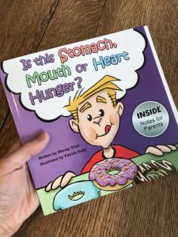
We eat for nourishment, comfort and joy!
Emotions get hungry too! Encourage talk in the classroom about emotions and don’t “quiet” all emotions.
Learn about Craving Change that teaches about different types of hunger…
Stomach hunger (physical or medical necessity to eat)
Mouth hunger (craving related to the senses)
Heart hunger (emotional trigger or learned behavior)
Check out the fullbloomproject.com that teaches how to teach kids to feel good inside their own bodies

Slide 25
We eat for nourishment, comfort and joy!
Jackie Santillan is an educational consultant who offers empathetic parenting (teaching) ideas. She focuses on the importance of words and HOW they worm into a child’s (student’s) psyche. Listen to how our “autopilot” words and phrases used in the classroom can potentially harm.
TikTok about “biting” words
https://www.tiktok.com/@kindminds_smarthearts/video/7082500639066148142?is_from_webapp=1&sender_device=pc&web_id=7091427519522260485
Tik Tok about Old Fashioned ways of doing things and dismissive speaking where we dismiss children’s emotions. We need to spend time promoting various ways of going through emotions.

Slide 26
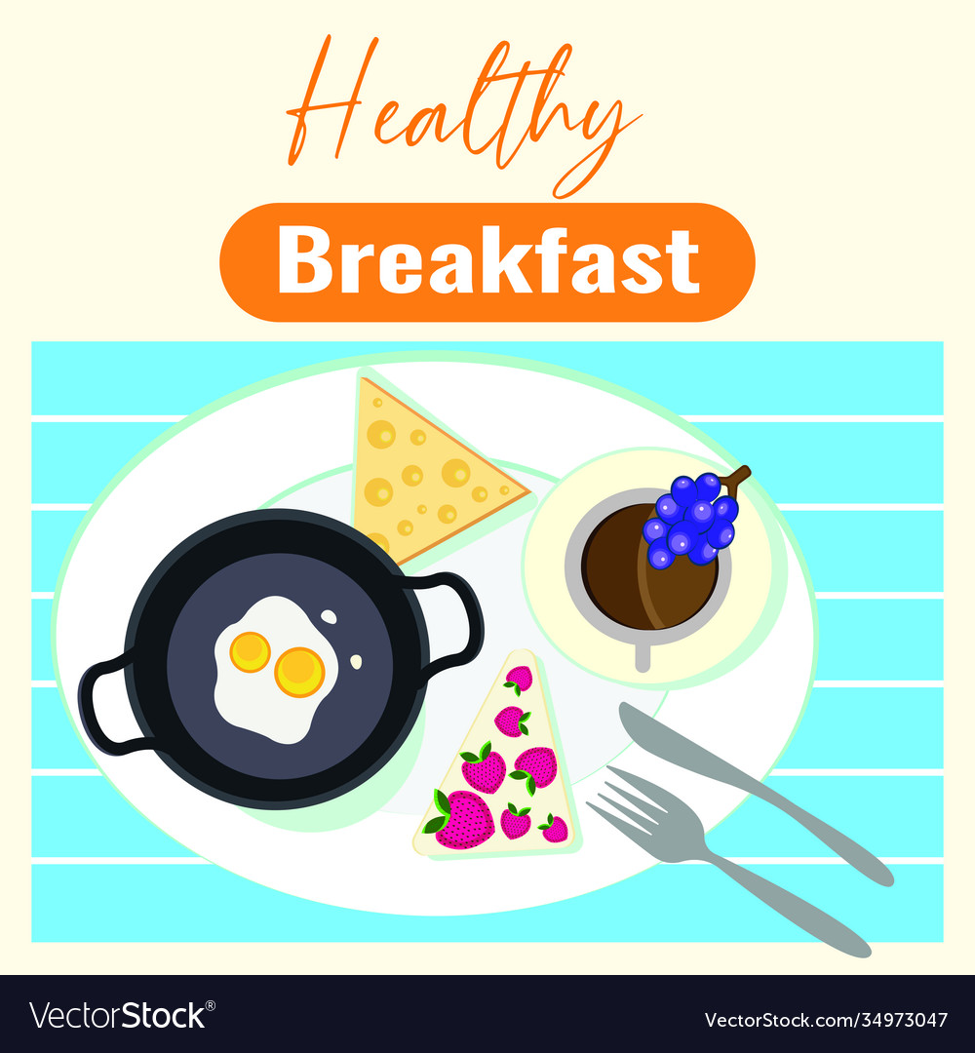
Is there anything about this poster for our breakfast program that may be an issue?
VS.

Slide 27
3. Tackling Putting Moral Value on Foods and beverages
Do you still promote that there is mostly a “right” and “wrong” way to eat? The words can be interchanged…good/bad, or healthy/unhealthy, clean/toxic
Do you ask students to come up with a linear good, better, best of foods? Compare one food over another? This suggests there is a hierarchy of foods. REFRAME your thinking and your words – ask students to use words that describe the food or the nutrients – chewy, crunchy, 6 grams of fibre, etc.

Slide 28
The “ALL FOODS CAN FIT” Approach
RAPID FIRE… answer the following to yourself…
Love or hate?
Sprinkles or no sprinkles?
Vanilla or other flavour?
Summer or anytime?
After dinner or after lunch?
Is it dessert or is it dinner?
Too high in sugar or too high in fat?

Slide 29
Foods vary in nutrient content
PICK the statement you might use…
There are foods that are higher in fibre and lower in fibre.
This cereal has 4 grams of fibre in 1 cup and this cereal has 1 gram of fibre in 1 cup.
This cereal is better for digestion as it has more fibre.
This cereal has too much sugar.

Slide 30
RIGID RESTRAINT or FLEXIBLE RESTRAINT
IF you are going to introduce food within the construct of balanced eating or for long-term sustainable eating, consider the learnings and evidence that suggests that ALL FOODS CAN FIT!
Rigid Restraint - characterized by all or nothing approach/forbidden foods
Flexible Restraint – a progressive approach that all foods are considered fine in moderate amounts
Ice cream for dinner? Why not? ~ Sarah Remner, RD.

Slide 31
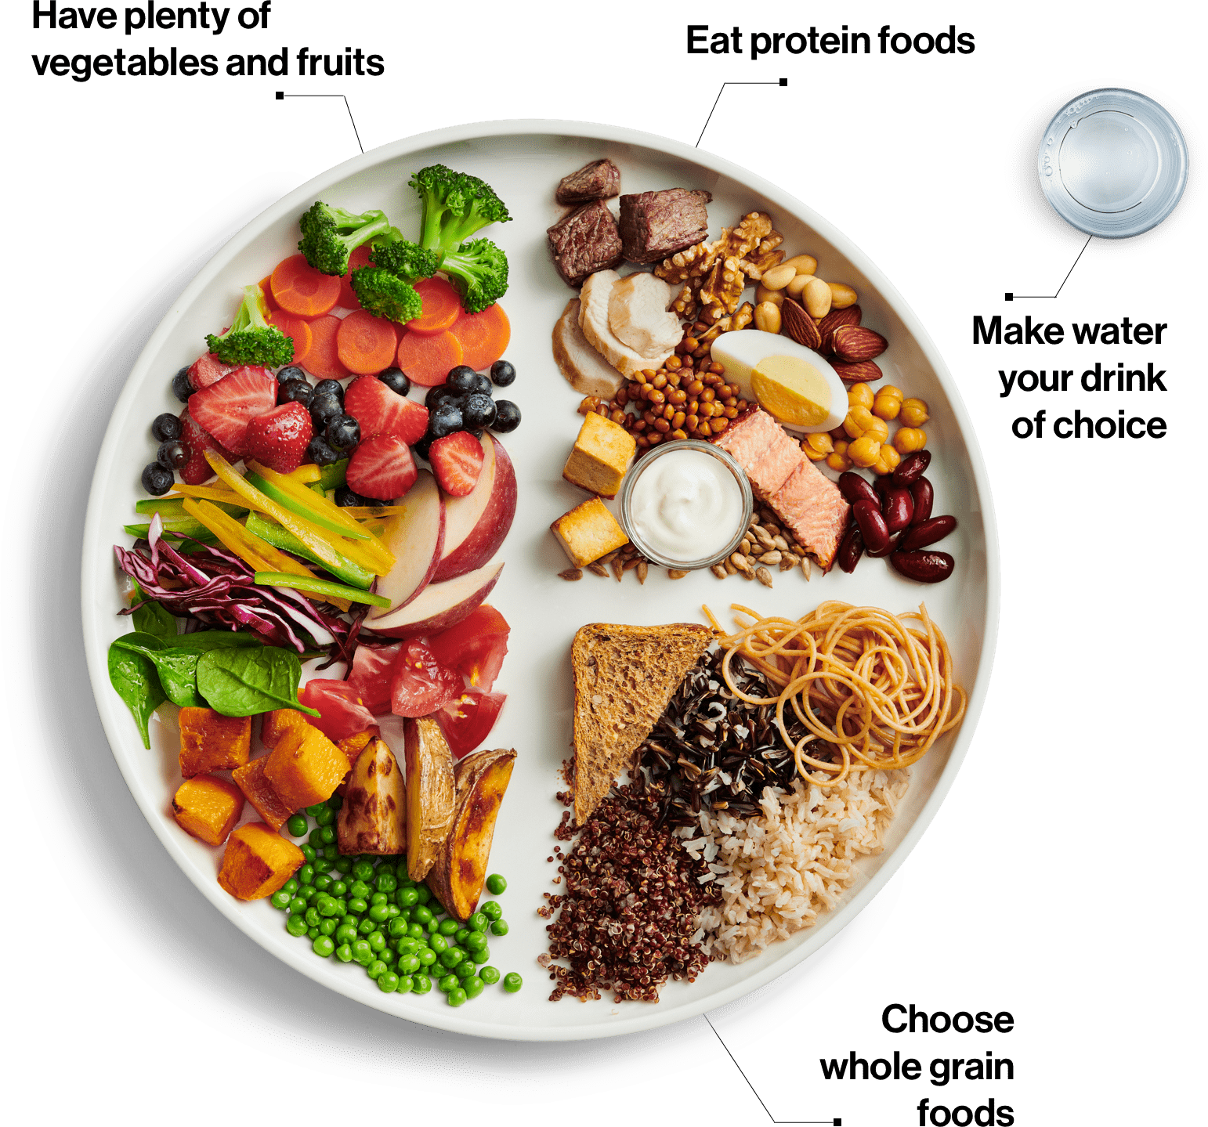
4. Tackling the Discrimination of Bodies of any kind
discrimination of anyone whose body doesn’t fit the narrow “ideal.”
discrimination of “ways of eating” that do not fit an “ideal”

Slide 32
Module 2: Reject it!
Knowing what resources extenuate diet culture in their intent either blatantly or covertly allows for the educator to carefully select ones that can be more effective in modeling choice language and systematic behaviour change.
Goal: Educators will learn how to suss out competent and credible resources – what to look for and what to reject.

Slide 33
Let’s MAKE it MAKE SENSE!
How to Spot an Unsafe Lesson Plan
These questions are designed to help teachers critically examine resources to help decipher if previously developed content in a lesson plan is body-neutral, food-neutral and movement-neutral. This resource was developed using a Guide for Guest Speakers developed by Gwen Kostal, RD from www.dietitians4teachers.ca

Slide 34
Word Document Checklist
Easy to follow question format.
Critical evaluation of a resource before classroom use.

Slide 35
How to Spot an Unsafe Lesson Plan
Questions. Does the resource… | No | Yes | If yes…
1. … use language that suggests certain foods and types of movement are “better” or “ideal” over other foods? |  |  | This lends itself to creating a hierarchy of foods and types of movement, not a neutral context.
2. … use language that assigns a moral directive to a food such as “guilt-free”, or “bad” |  |  | This undermines the opportunity to utilize body, nutrient or activity cues to prompt eating
3. … lead the user to categorize foods or eating behaviours as “healthy” or “unhealthy”? |  |  | Recognize that individuals have their own definition and context of what is healthy.
4. … suggest a specific dieting behaviour, dietary pattern or tracking of foods/nutrients? |  |  | The concept of steadily scrutinizing an eating pattern to fit a prescribed “ideal” pattern undermines freedom to enjoy foods for nourishment and celebration.
5. … use language that refers to body weight or body size? |  |  | To support body diversity, ensure no weighing, measuring, or anthropometric assessment of students occurs in any context.

Slide 36
How to Spot an Unsafe Lesson Plan
Questions. Does the resource… | No | Yes | If yes…
6. … suggest the pursuit of changes to body weight or body size? |  |  | This elevates certain body types over others and conveys the message that bodies that do not conform to a specific weight or size are not acceptable as they are.
7. … include emotionally charged questions or activities about bodies or eating patterns, or use triggering language? |  |  | Recognize that learners need to have a safe environment free of harassment or possibility of judgement. Questions or activities should not trigger guilt.
8. … not indicate when it was developed or last updated? |  |  | If there is no indication of when a resource was developed or last updated, take extra care to ensure that not only is it food- and weight-neutral, but that it aligns with the messaging of the current version of Canada’s Food Guide, which was released in 2019.
9. … have no further links to references, authorship, or publishing organization? |  |  | Without being able to check a resource’s credibility and review the author’s or organization’s objective, a resource may be less than altruistic. Resource materials should be well researched.

Slide 37
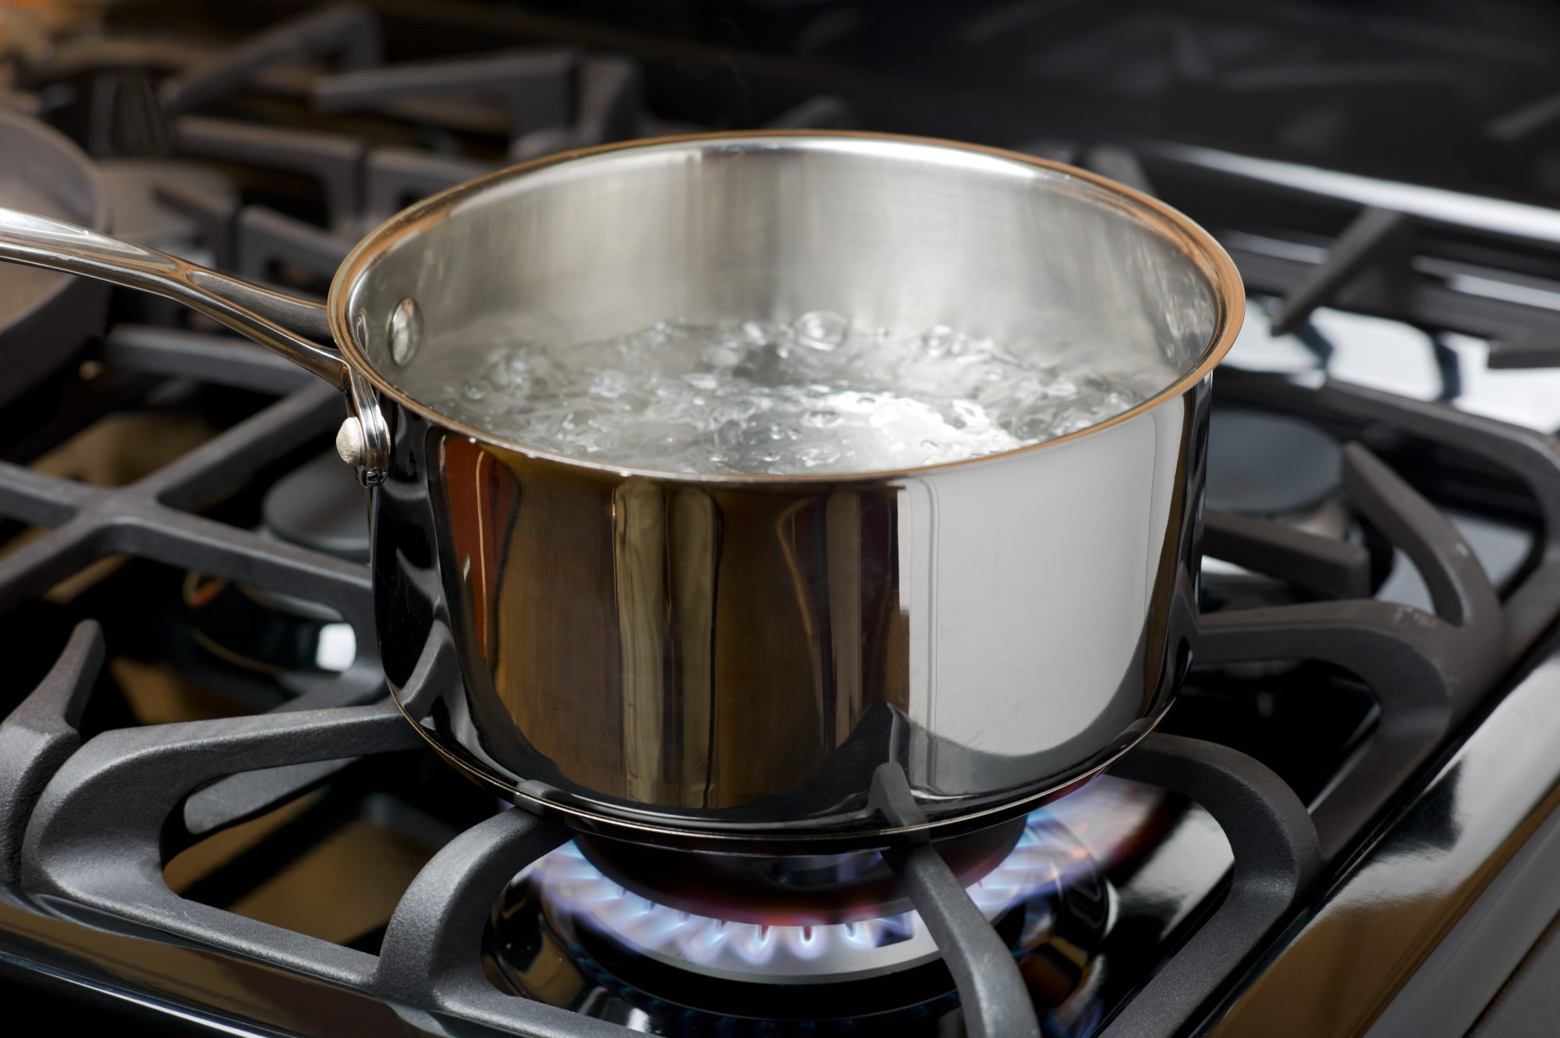
The Coffee Bean Story
Given what we know about the impact of diet culture on ourselves, on our students, on our kids, on our families, on our habits, on our communities and on our world…
It can be overwhelming on consider HOW we might tackle this monstrous issue effectively in our classrooms. The task may seem too difficult.
It work can be harsh, stressful, and feel like we are in a pot of boiling hot water.
What are you most overwhelmed with regarding tackling diet culture?

Slide 38
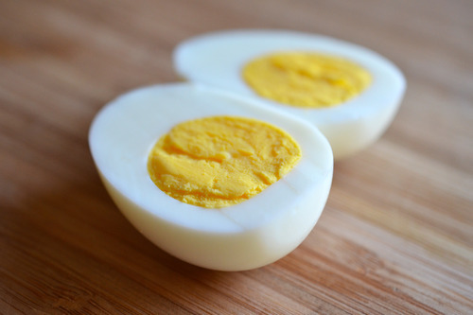
The Coffee Bean Story
Carrot
Egg
Coffee Bean

Slide 39
Understanding The Power Within The Coffee Bean Activity – for adults
In this activity you will: | Participants identify and explain the metaphor of the coffee bean and how people can allow for the environment to change them, or they can take what is inside them to make a difference to their environment.
Material: | Prepare large cards shaped like carrots, eggs and coffee beans for the participants to write on or prepare a jam board. | Duration: 10 minutes
Activity Description: Life is often difficult. It can be harsh, stressful, and feel like a pot of boiling hot water. The environments we find ourselves in can change, weaken, or harden us, and test who we truly are. Consider the pressures you might feel regarding trying to tackle diet culture in your classroom. Brainstorm the responses. Discuss how we can sometimes respond to stress like a carrot in boiling water. A carrot weakens in the pot. How do we sometimes weaken when trying to tackle diet culture? Discuss how we can be like an egg that hardens in the pot. How do we sometimes harden when trying to combat diet culture? Discuss how we can be like the coffee bean and discover the power inside us to transform our environment. Strategies and tools will be presented to help teachers learn how to reject diet culture. Metaphorically teachers can be coffee beans and search inside for what we already know and be encouraged to utilize the horrors of diet culture to motivate us to respond and teach in a constructive way to change our class environments and our students’ future world. The Coffee Bean is an inspiring book about unleash the unstoppable power within you. The Coffee Bean: A Simple Lesson to Create Positive Change (Jon Gordon) Hardcover – July 2, 2019

Slide 40
Module 3: Revise the Narrative!
NEXT SESSION…
May 30th, 2022
4:00 PM – 5:30 PM
A Guide to Terminology, Usage Tips and Definitions
Suggested resource connections
Where to link for further information and training

Slide 41
Thanks!
Do you have any questions?
ofsheea@ofsheea.ca
https://ofsheea.education/
See you on May 30^{th!}
Please complete the exit survey

Slide 42
References
Bradley, C. (2012). Servants, Housewives, Vixens, and the Ever-changing Apron. Cuizine.
https://doi.org/10.7202/1012455ar
Byrne, C. (2021, July 22). How to Reject Diet Culture In Every Part of Your Life. Christine Byrne Nutrition. https://christinejbyrne.com/how-to-reject-diet-culture/
Chastein, R. (n.d.). Recognizing and Resisting Diet Culture. National Eating Disorders Association. https://www.nationaleatingdisorders.org/blog/recognizing-and-resisting-diet-culture
https://www.npr.org/2021/12/23/1067210075/what-if-the-best-diet-is-to-reject-diet-culture
https://www.erudit.org/en/journals/cuizine/2012-v3-n2-cuizine0288/1012455ar/

