Slide 1
Before our Presentation
Please have your microphones muted during the presentation.
Our session is being recorded. Please turn off your camera if you do not want to appear on the recording.
If you have questions during the session, write them in the chat and the moderator will address them when appropriate during the presentation.

Slide 2
DIET CULTURE: Recognize it! Reject it! Revise the narrative!
OFSHEEA Guidance Document
Learning and Teaching About Body Acceptance, Weight Bias and Food Neutrality

Slide 3
Agenda – May 30, 2022 4 – 5:30pm
Welcome and Land Acknowledgement
Introductions
Project Overview
Revise the Narrative!
Consolidation and Gathering Feedback – survey link!

Slide 4
Thank You

Slide 5
Introduction
The Ontario Family Studies Home Economics Educators’ Association (OFSHEEA) facilitates professional development and personal growth of educators to promote quality Family Studies programs in Ontario. This guidance documents aims to support teachers with current information for teaching about and dismantling diet culture.
OFSHEEA understands that nutrition and social science knowledge is dynamic, and that curriculum can sometimes struggle to keep up with the latest findings. We aware of how popular media may sometimes portray nutrition science in a skewed way, and how associated health topics may often be misinterpreted. As social media continues to reinforce pervasive diet behaviours and diet culture, our classrooms must strive to be places where conversations about food and eating are meaningful for students, rather than rooms that teach nutrition and health concepts with short-sighted curriculum expectations in mind.
The resources found in this document are relevant to the date of publication.

Slide 6
The aim of this document
OFSHEEA’s goal with this guidance document is to begin unravelling diet culture by recognizing its associated behaviours
in ourselves,
in our classrooms and workplaces, and
in the broad community.
It is our hope that as an educator you will welcome learning more about, and recognizing, weight bias and diet culture, and that with this new knowledge, you will take the opportunity to reject diet culture and pass along how to reject it to your students. In addition, we anticipate you will become better versed at revising the narrative on diet culture in your classroom and workplace by landing on appropriate resources that use food neutral language and focus on strategies for enjoying food as nourishment and celebration.
Welcome to Diet Culture: Recognize it! Reject it! Revise the narrative!

Slide 7
The Document at a glance
MODULE 1: Recognize it!
MODULE 2: Reject it!
MODULE 3: Revise the Narrative
Deciphering and learning to see potential weight bias in ourselves.
Recognizing the words and activities that accentuate or promote diet culture.
Learning how to reject diet culture and pass on these strategies to our students.
Learning to suss out competent resources – what to look for and what to reject.
A Guide to Terminology, Usage Tips and Definitions
Suggested resource connections.
Where to link for further information and training.
Why?
Who?
How?
What?
Where?
Each module includes a comprehensive reference list and a glossary of terms.

Slide 8
Using the Guide
Each module includes one or more learning goals.
What We Know about the topic is presented.
Activities for Further Learning are suggested.
Key concepts or terms are redefined with CAN and CAUTION information for classroom use.
Adult Activity Ideas are offered for possible peer/colleague mentoring.
EACH Module is colour coded.

Slide 9
How to Spot an Unsafe Lesson Plan
These questions are designed to help teachers critically examine resources to help decipher if previously developed content in a lesson plan is body-neutral, food-neutral and movement-neutral. This resource was developed using a Guide for Guest Speakers developed by Gwen Kostal, RD from www.dietitians4teachers.ca

Slide 10
How to Spot an Unsafe Lesson Plan
Questions. Does the resource… | No | Yes | If yes…
1. … use language that suggests certain foods and types of movement are “better” or “ideal” over other foods? |  |  | This lends itself to creating a hierarchy of foods and types of movement, not a neutral context.
2. … use language that assigns a moral directive to a food such as “guilt-free”, or “bad” |  |  | This undermines the opportunity to utilize body, nutrient or activity cues to prompt eating
3. … lead the user to categorize foods or eating behaviours as “healthy” or “unhealthy”? |  |  | Recognize that individuals have their own definition and context of what is healthy.
4. … suggest a specific dieting behaviour, dietary pattern or tracking of foods/nutrients? |  |  | The concept of steadily scrutinizing an eating pattern to fit a prescribed “ideal” pattern undermines freedom to enjoy foods for nourishment and celebration.
5. … use language that refers to body weight or body size? |  |  | To support body diversity, ensure no weighing, measuring, or anthropometric assessment of students occurs in any context.

Slide 11
How to Spot an Unsafe Lesson Plan
Questions. Does the resource… | No | Yes | If yes…
6. … suggest the pursuit of changes to body weight or body size? |  |  | This elevates certain body types over others and conveys the message that bodies that do not conform to a specific weight or size are not acceptable as they are.
7. …include emotionally charged questions or activities about bodies or eating patterns, or use triggering language? |  |  | Recognize that learners need to have a safe environment free of harassment or possibility of judgement. Questions or activities should not trigger guilt.
8. … not indicate when it was developed or last updated? |  |  | If there is no indication of when a resource was developed or last updated, take extra care to ensure that not only is it food- and weight-neutral, but that it aligns with the messaging of the current version of Canada’s Food Guide, which was released in 2019.
9. … have no further links to references, authorship, or publishing organization? |  |  | Without being able to check a resources credibility and review the author’s or organization’s objective, a resource may be less than altruistic. Resource materials should be well researched.

Slide 12
Let’s look at resources!
BREAKOUT ROOMS Activity
Jamboard https://jamboard.google.com/d/1pyi0Wf606F-UkGjPWrU74Qeav4aFvQ4qmVIYWU4TLms/edit?usp=sharing
Is the resource body-neutral and food-neutral?
In your breakout room, decide if the resources provided are free of diet culture. Put a sticky note on each resource explaining your thoughts.
Remember to use the How to Spot an Unsafe Lesson Plan to guide your group.

Slide 13
HFN 10
HFN 2O
HFA 4C
HFA 4U
MODULE 3 - REVISE IT!
Looking at the Current Curriculum

Slide 14
Curriculum Expectations That Need to be Cautiously Taught
As teaching professionals, Family Studies teachers have the duty to recognize what current science is informing their curriculum. Though curriculum is developed and distributed at a finite time, the science informing the curriculum changes, and as such, teachers need to be abreast of current provincial guidelines, health recommendations, and documents that will supersede the curriculum and teacher prompts as written. Ontario’s current Family Studies curriculum was released in 2013.
The following examples of various specific expectations within Family Studies in Ontario have been selected to showcase how a teacher may need to update teaching prompts to reflect current provincial or federal guidance documents, and or current evidence informed concepts

Slide 15
What we’ve been teaching was consistent with evidence based guidelines, but now we need to empower teacher to recognize diet culture and model body inclusivity in the classroom.
Please do not feel shameful for what you’ve been teaching. Body positivity is a journey and we are all at different stages in our journey.

Slide 16
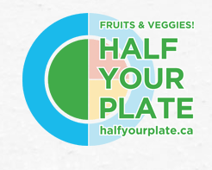
B1.7 Plan nutritionally adequate meals using the guidelines in Canada’s Food Guide
B1.3 Describe appropriate serving sizes as defined in Canada’s Food Guide
Suggestions:
Emphasize that half your plate can be full of colour from vegetables and fruit (keep in mind that not all produce is colourful (e.g. cauliflower, celery root).
Look to add vegetables and fruit to each meal/snack more often
Emphasize the plate model from the Food Guide.
Consider talking about the history of the Food Guide
HFN 2O1
RESOURCE #1
RESOURCE #2
RESOURCE #3
RESOURCE #4
Health Canada: History of CFG
Half Your Plate
OPHEA- Canada’s Food Guide
UN: Comparing Food Guides

Slide 17
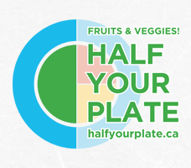
B2.1 Explain the differences between nutrient-dense foods and empty calorie foods and their effect on health
Suggestions:
Don’t focus on empty-calorie vs nutrient-dense (a calorie is a calorie)
Focus more on what nutrient density means (6 main nutrients etc.)
Look at the different nutrients that are in various foods
HFN 2O1
RESOURCE #1
RESOURCE #2
RESOURCE #3
RESOURCE #4
Government of Canada: Nutrients in Foods
Fruit and Vegetable Fact Sheet
Unlock Food: Understanding Food Labels
Whole Grains Council

Slide 18
B2.2 Explain why it is important to eat a nutritious breakfast (e.g., to improve mood, energy level, school performance, workplace productivity)
Suggestions:
This is okay to talk about but be mindful/respectful of students who do not eat breakfast.
Focus on school alertness and NOT weight (watch your resources)
Teach students to listen to their body cues (hunger, thirst and fullness) and normalize that some days bodies are more hungry than other days
HFN 2O1
RESOURCE #1
RESOURCE #2
RESOURCE #3
RESOURCE #4
Mastering Mindful Eating
Craving Change: Our Relationship with Food
Ontario Dietitians in Public Health
What Breakfast Looks Like Around the World

Slide 19
B2.4 Evaluate existing programs and policies that encourage eating for optimal health (e.g., breakfast programs, school food and beverage policies, trans fat regulations)
Suggestions:
Remember that these policies need to be looked at with a critical lens.
HFN 2O1
RESOURCE #1
RESOURCE #2
RESOURCE #3
RESOURCE #4
Recipes for Schools
School Food and Beverage Policy
Student Nutrition Guidelines
Tackling Trans Fats

Slide 20
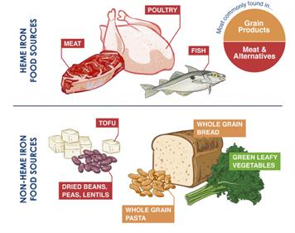
B2.5 Assess their own eating patterns and create a personal eating plan to achieve optimal physical health
Suggestions:
Do not have students track their food intake (this buys into the diet culture)
Rather, have students focus on Canada’s Food Guide Healthy Eating Recommendations (be mindful of your eating habits, cook more often etc.)
HFN 2O1
RESOURCE #1
RESOURCE #2
RESOURCE #3
RESOURCE #4
Focus on Key Nutrients and Comparing Their Content in Various Foods: More Iron, Fibre and Calcium!
Let’s Talk About Food - A Masterful Resource of Lessons focusing on what food has to offer!
Mindfulness and Mindful Eating in the Classroom
Health Canada: Canada’s Dietary Guidelines

Slide 21
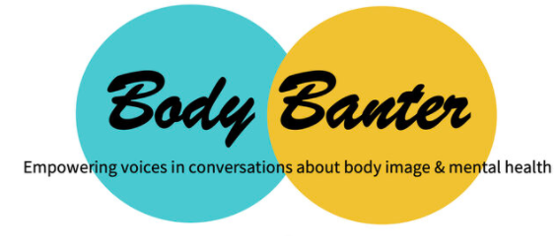
B3.1 Describe positive and negative influences on body image (e.g., cultural, social, media, peer group, family).
B3.2 Describe and evaluate some current theories about the relationship between body type/shapes and health (e.g., different shapes can be healthy; waist circumference is a predictor of diabetes)
B3.3 Outline strategies for achieving and maintaining a positive body image and healthy attitudes about food (e.g., critically examine media messages, educating oneself about trends, using positive self-talk, setting priorities, participating in varied activities, talking with others)
Suggestions:
This is highly problematic and should be handled with care. Critique the current systems in place (BMI etc.)
Use positive body image resources – Further learning and information is in the key concepts
HFN 2O1
RESOURCE #1
RESOURCE #2
RESOURCE #3
RESOURCE #4
Body Banter: Positive Conversations
Butterfly: Body Positivity
Media Smarts: Body Image
Nedic: Body Image Resource

Slide 22
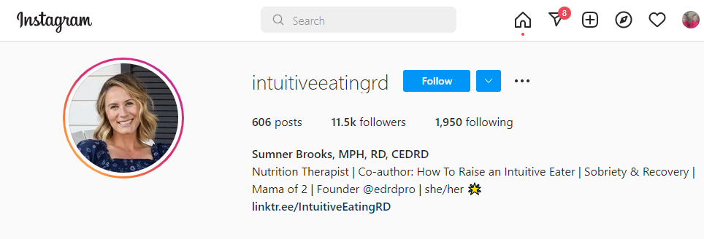
C2.3 Explain how childhood eating habits can influence lifelong eating patterns
Suggestions:
Remember to not shame students for unhealthy eating habits and poor diet quality. For some students, how they eat is not a function of habit, but what’s available to them.
Try to connect this with Canada’s Food Guide Healthy Eating Recommendations ( be mindful of your eating habits, cook more often etc.)
Teach students to listen to their body cues (hunger, thirst and fullness) and normalize that some days bodies are more hungry than other days.
REMEMBER that our understanding of one “healthy” pattern is false.
HFN 2O1
RESOURCE #1
RESOURCE #2
RESOURCE #3
RESOURCE #4
Sumner Brooks: Nutrition Therapist Co-author: How To Raise an Intuitive Eater
Healthy Eating Recommendations
Health Canada: Canada’s Dietary Guidelines
Therese Kenny SSc, PhD: Changing the Diet Culture

Slide 23
B1. 2 Describe the causes and symptoms of nutrient deficiencies (e.g., rickets, pellagra, goiter, anemia, osteoporosis, scurvy, kwashiorkor, marasmus, beriberi) and excess (e.g., iron toxicity, fluorosis)
Suggestions:
Focus on what the diseases are
Look at why there may be a prevalence (food insecurity in various location in Canada)
HFA 4U/C
RESOURCE #1
RESOURCE #2
RESOURCE #3
RESOURCE #4
Fruits and Vegetables and Their Nutrients
Importance of Folate
Fruit and Vegetable Fact Sheet
Cooking and Food Articles

Slide 24
B1.3 Analyze foods to determine their nutrient content, using available food and nutrition information (e.g., Nutrition Facts tables, food company nutrition information, nutrient-values database, information provided by health and nutrition professionals)
Suggestions:
Be mindful of food shaming when analyzing specific foods.
When looking at food labels, teach to compare without judgement. For example, which has more protein, which has more fiber etc.
Be aware of the misconception of if you can’t pronounce it, you should eat it.
Teach about allergies on food labels.
HFA 4U/C
RESOURCE #1
RESOURCE #2
RESOURCE #3
RESOURCE #4
Government of Canada: Understanding Food Labels
Understanding Food Labels in Canada
Sick Kids: Food Labels
Nutrient Claims

Slide 25
B2.2 Outline the main nutrients found in each of the food groups in Canada’s Food Guide (e.g., carbohydrates in the Grain Products group, protein in the Meat and Alternatives and Milk and Alternatives groups)
Suggestions:
Canada’s current Food Guide has changed in a positive direction.
It’s important to note that Milk and Alternatives and Meat and Alternatives have not been omitted, rather combined into one group, proteins.
HFA 4U/C
RESOURCE #1
RESOURCE #2
RESOURCE #3
RESOURCE #4
Fruit and Vegetable Fact Sheet
Government of Canada: Nutrients in Foods
Fruits and Vegetables and Their Nutrients
Whole Grains Council

Slide 26
B3.4 Analyze and interpret data to determine how various factors affect calorie expenditure (e.g., data about duration and intensity of exercise, body composition, basal metabolic rate, energy for various forms of activity)
Suggestions:
This is highly problematic and should be handled with care.
Critique the current systems in place (BMI etc.)
Make sure to use positive body image resources.
*These resources below are teacher resources and should not be used in the classroom.
HFA 4U/C
RESOURCE #1
RESOURCE #2
RESOURCE #3
RESOURCE #4
*Why BMI is a Flawed Measure
Butterfly: Body Positivity
Body Banter: Positive Conversations
*The Problem With BMI

Slide 27
B4.1 Analyze their own nutrients intake with reference to current Canadian guidelines (e.g., Dietary Reference Intakes)
B4.2 Compare their own nutrient intake with that of various population groups in Canada
Suggestions:
Do not have students track their food intake (this buys into the diet culture)
Rather, have students focus on Canada’s Food Guide Healthy Eating Recommendations (be mindful of your eating habits, cook more often etc.)
Talk about the life cycle and which nutrients are most important for certain individuals.
HFA 4U/C
RESOURCE #1
RESOURCE #2
RESOURCE #3
RESOURCE #4
Healthy Eating While Pregnant and Breastfeeding
British Heart Foundation: Intuitive Eating
Mastering Mindful Eating
Mindfulness and Mindful Eating in the Classroom

Slide 28
C2.1 Explain why certain eating practices are associated with the prevention and management of particular health conditions (e.g., allergies, diabetes, cardiovascular disease, osteoporosis, kidney disease)
Suggestions:
Don’t teach about what causes these diseases, but rather what the disease is.
HFA 4U/C
RESOURCE #1
RESOURCE #2
RESOURCE #3
RESOURCE #4
Government of Canada: Food Allergies
Kids Health: Food Allergies
Nutrition Across the Lifespan
Seniors Nutrition

Slide 29
C2.2 Explain the relationship between particular social and emotional conditions (e.g., busy schedules, expectations related to body shape, stress, scarcity of resources) and unhealthy eating patterns that can contribute to illness and disease
Suggestions:
Teach the concepts of Mindful Eating and Intuitive Eating
Did you know that mindfulness ties in directly to exploring Canada’s Food Guide? One eating habit highlighted in CFG is to “be mindful of your eating habits.”
Teach students to listen to their body cues (hunger, thirst and fullness) and normalize that some days bodies are more hungry than other days.
HFA 4U/C
RESOURCE #1
RESOURCE #2
RESOURCE #3
RESOURCE #4
Healthy Eating Recommendations
Sumner Brooks: Nutrition Therapist Co-author: How To Raise an Intuitive Eater
Mastering Mindful Eating
Mindfulness and Mindful Eating in the Classroom

Slide 30
C2.3 Assess the role of various factors (e.g., heredity/genetics, socio-economic status, geography, lifestyle, activity level) in nutrition-related illnesses and health conditions
C2.5 Identify and evaluate strategies to prevent food-and nutrition-related diseases and illnesses
Suggestions:
Remember to not shame students for unhealthy eating habits. Try to connect this with Canada’s Food Guide Healthy Eating Recommendations (be mindful of your eating habits, cook more often etc.)
Focus mostly on what the disease is and its prevalence. Consider conversations as to why there is a prevalence.
Look at food insecurity in Canada and around the world.
HFA 4U/C
RESOURCE #1
RESOURCE #2
RESOURCE #3
RESOURCE #4
Food Insecurity in Indigenous Communities
Healthy Eating Recommendations
Let’s Talk About Food: A Masterful Resource of Lessons focusing on what food has to offer!
AgScape: Lesson on Food Security

Slide 31
C3.2 Explain why people adopt various eating patterns (e.g., vegetarian diet, slow food diet, organic diet, local food diet, weight-loss programs)
Suggestions:
Again, be mindful that a lot of these buy into the diet culture.
Be cautious not to teach about weight-loss programs.
Talk about current food trends
HFA 4U/C
RESOURCE #1
RESOURCE #2
RESOURCE #3
RESOURCE #4
AgScape: Local Food #1
AgScape: Local Food #2
Understanding Organic vs Non-Organic Foods
Why Buy Local

Slide 32
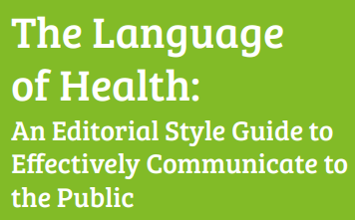
Additional Resources
Weight Neutral Schools
Maggie Landes MD MPH
Food Education and Neutrality
What’s in a Word? On Weight Stigma and Terminology
Cori Lorts, PhD, RDN
Diet Culture in the Classroom
Weight Related Conversation Resources

Slide 33
Recognize It! Reject It! Revise the Narrative!
Before we move forward together, we need to look inside (Recognize) and look at how (Reject) history and keeping the status quo has shaped and continues to shape the spaces we create.
When we do this, it might be hard.
You are encouraged to consider how fatphobia, ableism, racism, and other biases impact the work that you do.
From the work of Sonya Renee Taylor, she suggests we ask ourselves, "What biases am I holding against my own body? How am I working to heal my relationship with my body?"
The pursuit of “health,” normatively and narrowly defined, reproduces ableism as it asks everyone to aim for one singular standard of bodily “achievement.”
https://nedic.ca/blog/reflection-nedic2019/

Slide 34
Trigger Words, Terminology, and What Words Mean.
What do our words really mean? How do we use them correctly?
“Overweight”
“Obese or Obesity”
“Fat”
Being overweight is a matter of opinion; if someone is “comfortable in their own skin” and “feels healthy” they are not overweight.
In the past, and even now, "obesity" was deemed a chronic disease; a medically-definable condition. We reinforce the stigma associated with labelling a body with obesity. It is calling a body a problem and it makes the assumption that there is a “cure” for a body size.
“In its nature, the word fat is not inherently bad.
When we react to its use in a way that shuts down people who use it to describe themselves, we are saying that there is something wrong with being fat, which there is not.
REMEMBER to Revise the Narrative!
Notes:
We want to prevent negative connotations with our words.
Being overweight is a matter of opinion; if someone is “comfortable in their own skin” and “feels healthy” they are not overweight.
Consider the terms with the prefix “ab” - abnormal, absent, aboriginal. The aboriginal word is weaning as a descriptor as it contorts some kind of “ab” or “mal” to an original.
Negative reactions against the word “fat” as descriptor often (but not always) come from people who exist in smaller bodies.
Questions I’ve had include: “I encourage my clients not to use the word fat, because they are putting themselves down when they call themselves fat, so why are you using it to describe people?” or “I don’t think people in the Health at Every Size/body positivity/size acceptance/eating disorders field would appreciate you calling people fat, so can you please not do that?” and even “we don’t say that people are cancer or diabetes, we say that they have those things.”
I think it’s important to be clear that when we--when I, as a thin person--use the word fat in these contexts, I am drawing on the word that many people use to describe themselves in a neutral or positive way. It is not up to me to define someone’s body size. It is not up to me to tell someone how to refer to their own body. Not everyone wants to use the word fat to describe their bodies--and that is ok, too. However, many fat activists have reclaimed the word fat, which has been used to harm in the past (see this interview with Sophie Hagen or more on why it is important to reclaim the word fat). In its nature, the word fat is not inherently bad. When we react to its use in a way that shuts down people who use it to describe themselves, we are saying that there is something wrong with being fat, which there is not.
Size should not be an insult or a barrier to happiness.
In the past, and even now, "obesity" was deemed a chronic disease; a medically-definable condition. We reinforce the stigma associated with labelling a body with obesity. It is calling a body a problem and it makes the assumption that there is a “cure” for a body size.
https://nedic.ca/blog/reflection-nedic2019/

Slide 35
Recognize It! Reject It! Revise the Narrative!
Notes:
Last week the world celebrated World Lindy Hop Day on May 26th! The instructors in this video did a great job of suggesting how to “recognize” when we don’t know the whole story, how to “reject” stereotypical thinking, and how to “revise the narrative” by going the distance to learn before speaking out of turn.

Slide 36
References for Terminology and Further Reading
Meadows, A., & Daníelsdóttir, S. (2016). What's in a Word? On Weight Stigma and Terminology. Frontiers in psychology, 7, 1527. https://doi.org/10.3389/fpsyg.2016.01527
The work of Sonya Renee Taylor on body empowerment:
https://www.sonyareneetaylor.com/
Association for Size Diversity and Health (ASDAH):
https://asdah.org/health-at-every-size-haes-approach/

Slide 37
What 's Next?
Constructive Listening Dyads
With your partner start by introducing yourself and selecting a timekeeper (1 min)
Select one or more of the questions below.
Partner A shares for 90 seconds. Partner B listens.
Partner B shares for 90 seconds. Partner A listens.
How might you use it in your classroom? (1 min)
Once complete, please add your answers to the Google Doc https://docs.google.com/document/d/19zOf4D0PLh9QfTZmDc3I40qemIhtvOzi_mIoafRP1TM/edit?usp=sharing
What can OFSHEEA provide you with?
#1 Takeaway from today
What are you still worried about?

Slide 38
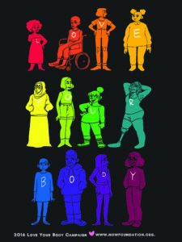
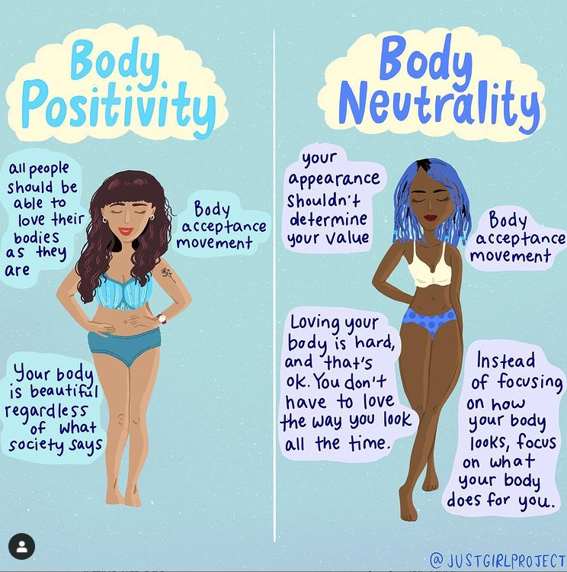
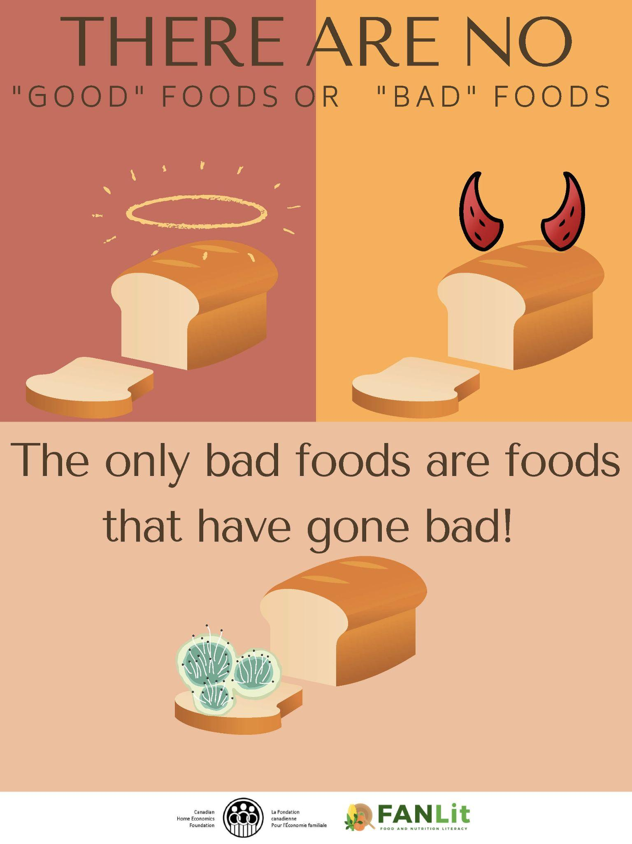
Posters (available in the shared Google Folder)

Slide 39
Thanks!
Do you have any questions?
ofsheea@ofsheea.ca
https://ofsheea.education/
Please complete the exit survey found at https://forms.gle/JV5BfBN5fXc3jxeb8

