Slide 1
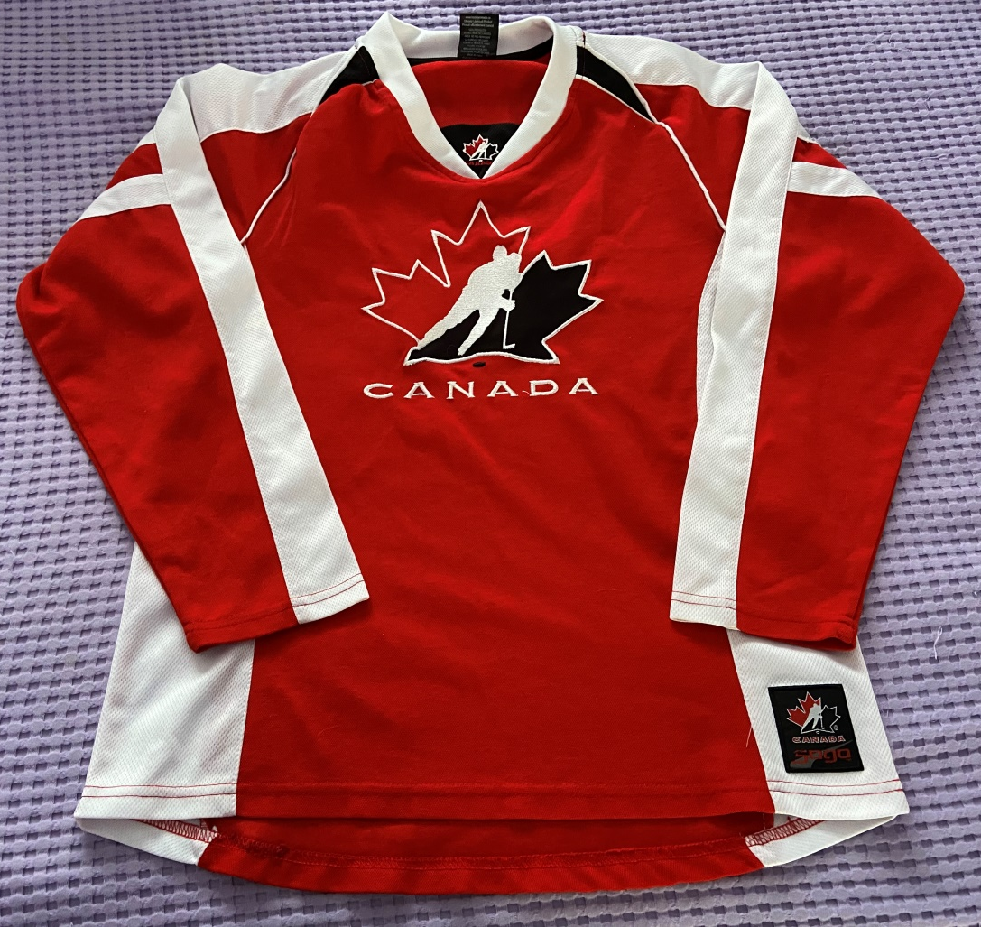
Canadian Wardrobe
Cultural Traditions
Heather Smith-Hudson

Slide 2
Bangladesh – Sari Source: G. Alam

Slide 3
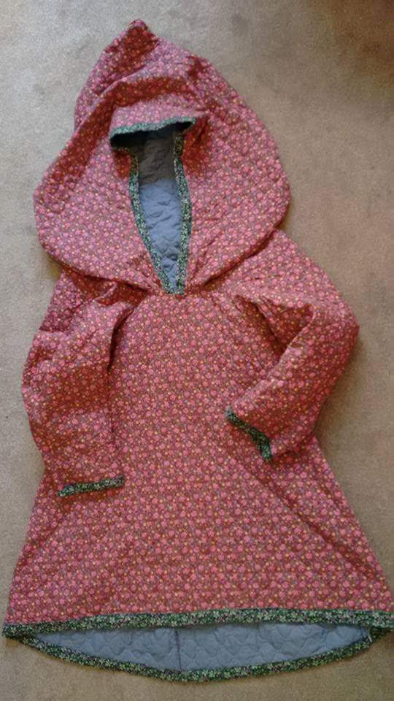
Nunavut, Canada – Amauti Source: L Watson

Slide 4
China – Chinese New Year Outfit Source: K. Wong

Slide 5
Egypt – Kaftan/Caftan Source: J. Hudson

Slide 6
Germany – Dirndl Source: C. Mackenzie

Slide 7
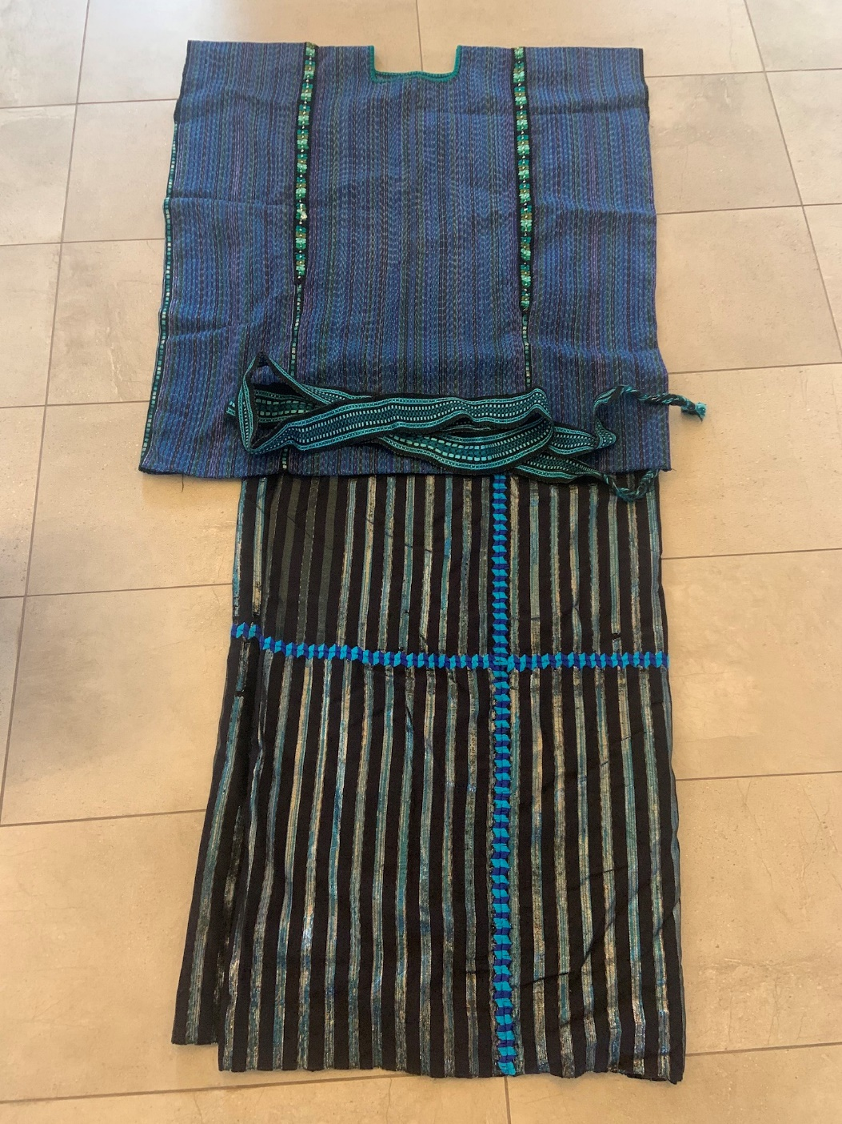
Guatemala – Traditional Guatemalan Clothing Source: M. Chapman

Slide 8
India – Sari Source: B. Bekaan

Slide 9
Japan – Kimono Source: H. Smith-Hudson

Slide 10
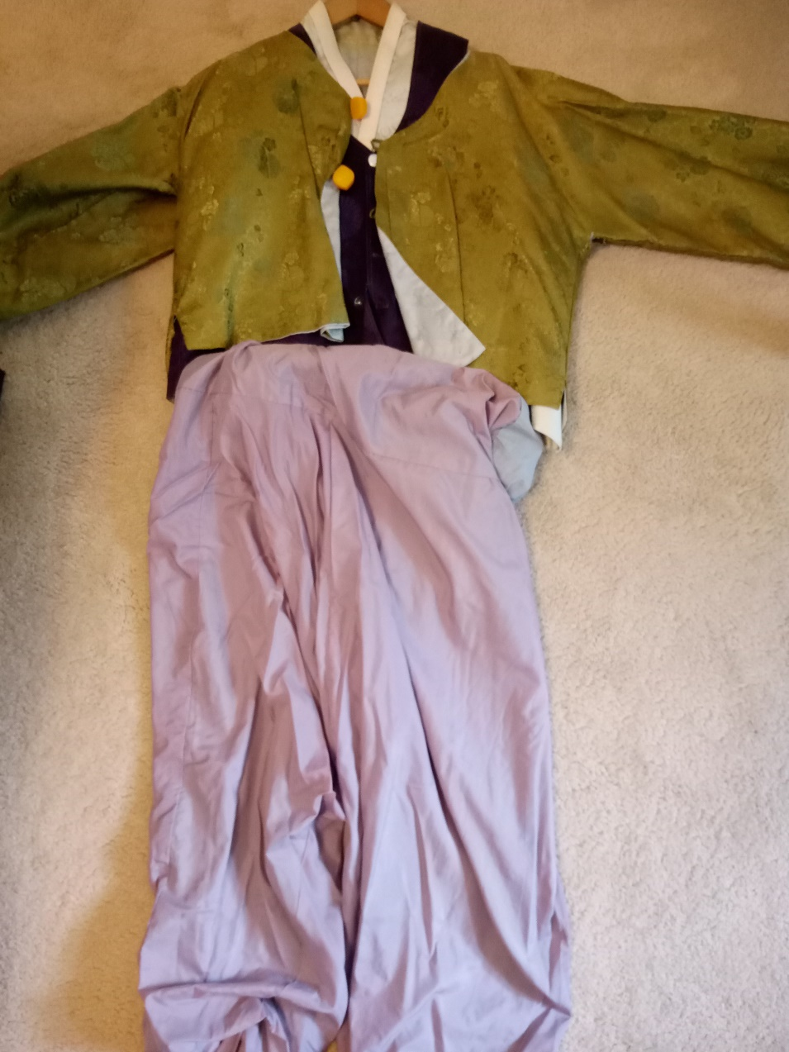
Korea – Traditional Wedding Clothing Source: R. Yu

Slide 11
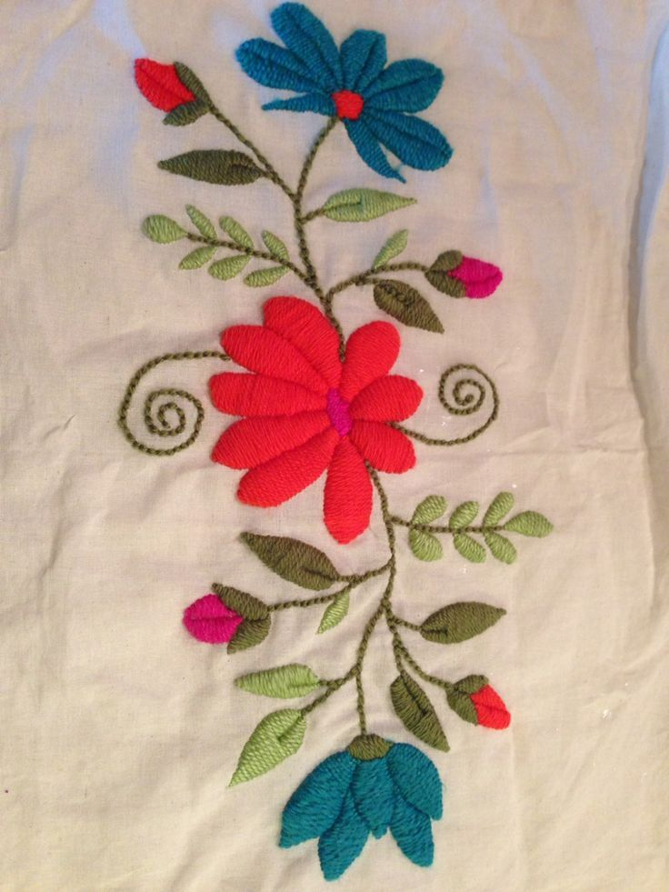
Mexico - Bordados
Photo Credit: https://www.google.com/imgres?imgurl=https://i.pinimg.com/originals/be/79/1b/be791b544da658c4dd0e64306a065623.jpg&imgrefurl=https://www.pinterest.com/pin/357684395384948574/&docid=P2R2ve3kgsAn_M&tbnid=afXQQO_XXMILoM&vet=1&w=736&h=981&hl=en&source=sh/x/im
Video - EMBROIDERING SPLIT STITCH OR POINT DIVISION STEP BY STEP - https://www.youtube.com/watch?v=OBj8KScKIiA

Slide 12
Netherlands – Wooden Shoes and Clothe Hat from Friesland Source: A. Smith

Slide 13
Palestine – Palestinian Dress Source: M. AbuSharkh

Slide 14
Scotland – Kilt Source: N. Hudson

Slide 15
Websites To View for More Examples
https://indigenouspeoplesatlasofcanada.ca/article/clothing/
https://reddressembroidery.com/
https://artsandculture.google.com/project/we-wear-culture
https://artsandculture.google.com/theme/explore-traditional-clothing-from-around-the-world/-gLSnpTzzdkwJw?hl=en
roughguides.com/gallery/traditional-dress/
https://www.thecultureist.com/2014/11/28/31-traditional-forms-dress-around-world/amp/

Slide 16
Your Turn! Cultural Traditions Activity (see handout)…
What item of clothing do you own that has cultural significance for you or your family?
Choose an item of clothing from two other cultures.

Slide 17
Questions?

