Slide 1
Communication HIF1O/2O: Exploring Family Studies

Slide 2
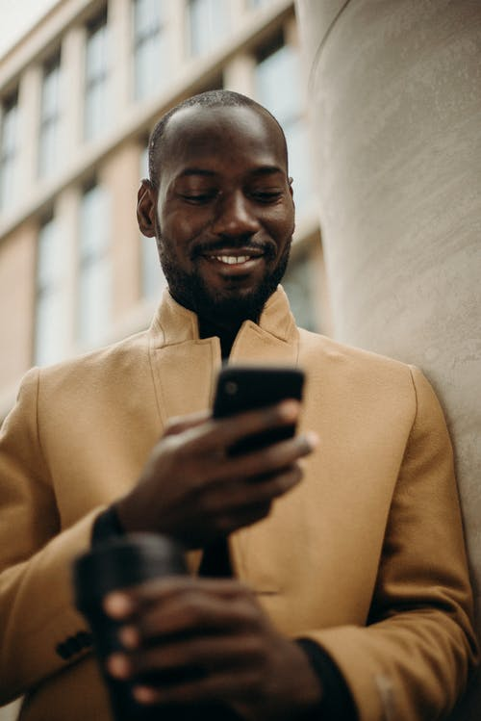
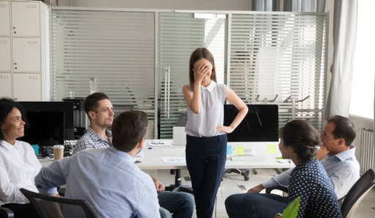
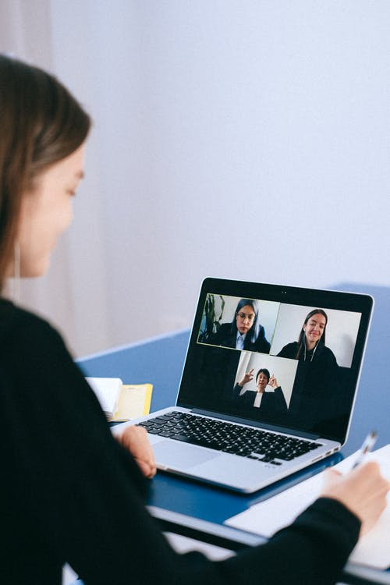
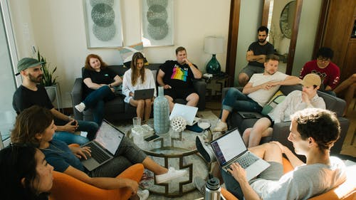
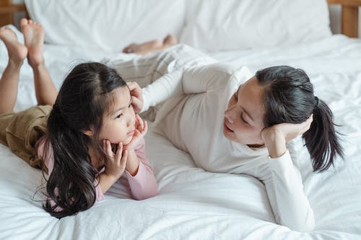
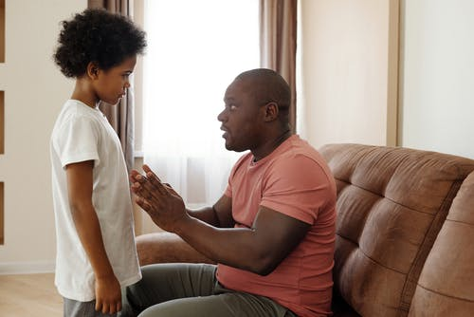
What Is COMMUNICATION?
Communication is when two or more people exchange information
Communication involves someone that sends a message and someone that receives a message
Notes:
(Teen Talk, n.d.)

Slide 3
How Can We Communicate With Others?
Face to face (speaking with someone in person)
On the phone
Through text messages
Through e-mails
On social media
Regular mail
Notes:
(Teen Talk, n.d.)

Slide 4
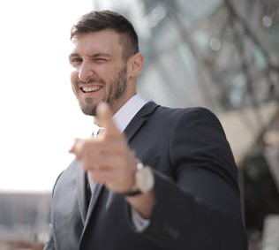
How Do We Send Messages?
Verbal Communication
This is communication that involves words
Examples: talking with a friend on the phone, sending an e-mail or text message
Non-verbal Communication
This is communication that does not involve words
This is called body language
Notes:
(Clovis Community College, 2021)
(Meriorg & Holloway, 2001)

Slide 5
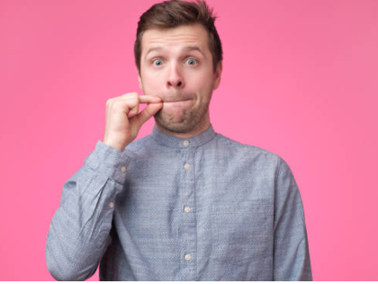
What Is Body Language?
Body language involves using your face or body to communicate a message or how you feel
Examples:
Nodding your head to say yes or to agree with someone
Smiling to show that you are happy
Crossing your arms to show that you are unhappy or uncomfortable
Sometimes you can send a non-verbal message without even realizing it
Notes:
(Meriorg & Holloway, 2001)

Slide 6
Body Language Around The World
Body language is an important part of communication, but it does not have the same meaning everywhere in the world.
We need to be aware of these differences to avoid miscommunication.
For example:
In Canada, it is considered polite to maintain eye contact with someone you are having a conversation with or listening to.
In some countries around the world, eye contact is considered disrespectful or aggressive

Slide 7
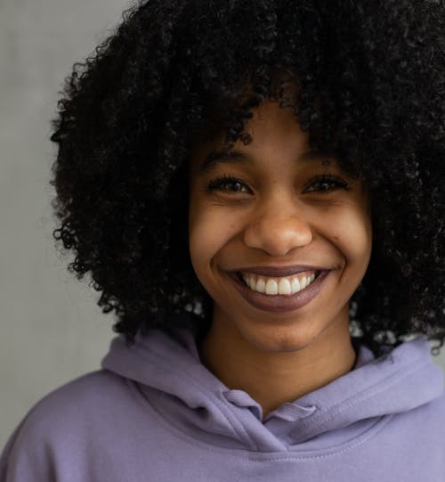
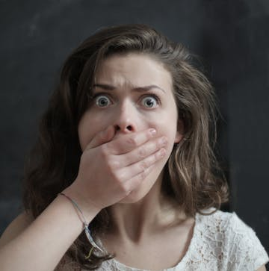
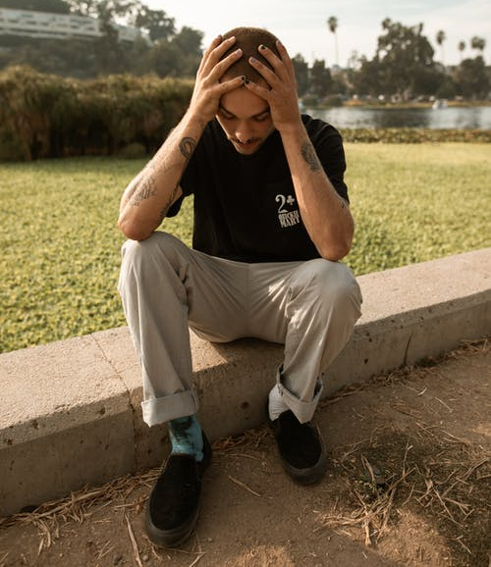
What Messages Are The People In These Pictures Sending?
3
1
2
4
Notes:
The teacher should have a discussion on cultural awareness in relation to this slide. Not every culture will interpret these forms of body language in the same way. It is important for students to become aware of these cultural differences.

Slide 8
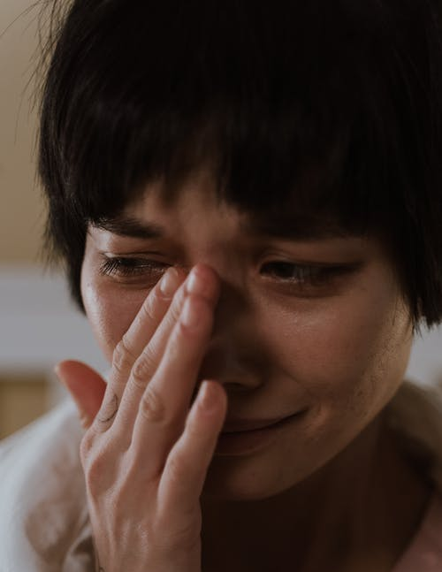
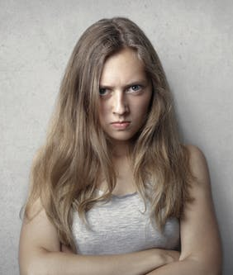
What Messages Are The People In These Pictures Sending?
8
5
7
9
6
Notes:
The teacher should have a discussion on cultural awareness in relation to this slide. Not every culture will interpret these forms of body language in the same way. It is important for students to become aware of these cultural differences.

Slide 9
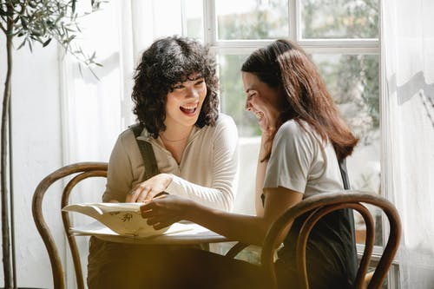
How Do We RECEIVE Messages?
Active Listening
This is when you carefully listen to a speaker and give them your full attention
You pay attention to what the speaker is saying so that you can try to understand what they are telling you
Active listeners show they are listening through verbal and non-verbal communication
Passive Listening
This is when you hear someone speaking, but you are not
really paying attention to what they are saying
Passive listeners are often distracted
Notes:
(Oxford Learning, 2017)

Slide 10
ACTIVE Vs. Passive Listening
Which one of these pictures is an example of Active Listening?
How do you know?
Which one of these pictures is an example of Passive Listening?
How do you know?

Slide 11
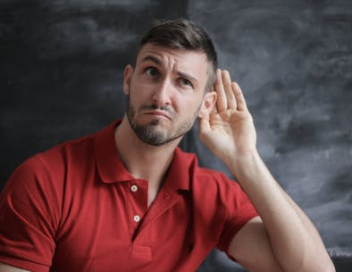
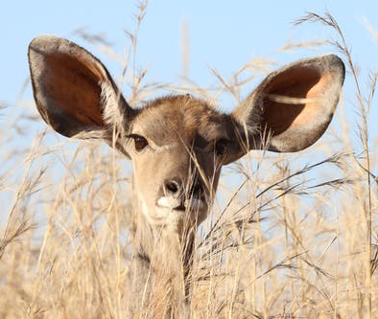
How Can I Be A Better Listener?
Focus on what the speaker is saying
Try to understand what the speaker is trying to tell you
What is the purpose of this conversation?
Connect to the speaker
Make eye contact
Do not turn away from the speaker
Don’t interrupt the speaker
Control your emotions
Ask questions
Notes:
(Meriorg & Holloway, 2001)
(Oxford Learning, 2017)

Slide 12
Communication Styles

Slide 13
What Are The The Three Types Of Communication?
Passive Communication
Aggressive Communication
Assertive Communication
Notes:
(Teen Talk, n.d.)

Slide 14
What does Passive Communication Look Like?
It is when someone…
Does not directly express their thoughts or feelings
Puts the needs of others before their own
Does not stand up for themselves
Stays quiet (even if something is bothering them)
Often agrees to do something they may not want to do
This communication style is not ideal because your thoughts won’t be heard. You will also often have your decisions made for you.
Notes:
(Teen Talk, n.d.)
(Skeen, McKay, Fanning, & Skeen, 2016)
(Clipartmax, n.d.)

Slide 15
Passive Communication: Discussion Questions
Why might someone communicate in a passive way?
When might it be a good idea to use passive communication?
When might it be a bad idea to use passive communication?
Notes:
(Teen Talk, n.d.)
(Skeen, McKay, Fanning, & Skeen, 2016)
(Clipartmax, n.d.)

Slide 16
What Does Aggressive Communication Look Like?
It is when someone…
Puts their own needs and wants before others
Tells others how they feel without worrying if they will hurt someone else’s feelings
Always needs to have everything go their way
Displays hurtful behaviours
Examples: intimidation, bullying, sarcasm, put-downs, etc.
Uses negative body language
This communication style is not ideal because others will most likely view you as being too controlling or bossy.
Notes:
(Teen Talk, n.d.)
(Skeen, McKay, Fanning, & Skeen, 2016)
(Clipartmax, n.d.)

Slide 17
Aggressive Communication: Discussion Questions
Why might someone communicate in an aggressive way?
When might it be a good idea to use aggressive communication?
When might it be a bad idea to use aggressive communication?
Notes:
(Teen Talk, n.d.)
(Skeen, McKay, Fanning, & Skeen, 2016)
(Clipartmax, n.d.)

Slide 18
What Does Assertive Communication Look Like?
It is when someone…
Gets what they want without disrespecting others
Talks, but also listens to other people
Remains respectful at all times
Displays positive body language
This communication style is ideal because you are able to get what you want, while maintaining positive relationships with others.
Notes:
(Teen Talk, n.d.)
(Skeen, McKay, Fanning, & Skeen, 2016)
(Clipartmax, n.d.)

Slide 19
How Does Mr. Bean Communicate?
As you are watching the video, think about…
How does Mr. Bean communicate?
Is Mr. Bean’s behaviour appropriate for a restaurant?
Why? Why not?
Link to video: https://www.youtube.com/watch?v=veZOrXVHf7U
Notes:
(Mr. Bean, 2009) https://www.youtube.com/watch?v=veZOrXVHf7U

Slide 20
Credits.
Presentation Template: SlidesMania
To comply with this template's license, you have to keep this slide or mention us and the other resources used in the footer.

