Slide 1
Decision Making
HIF1O/2O: Exploring Family Studies

Slide 2
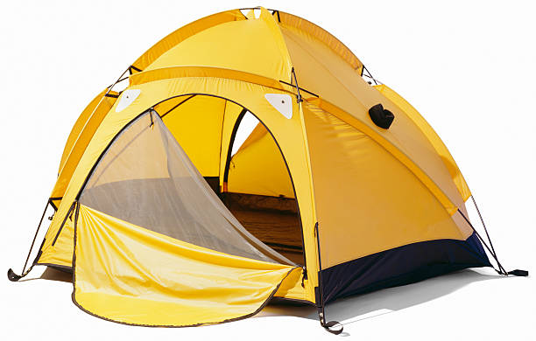
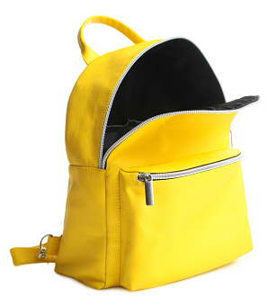
Minds-On Activity: Remote Island
If you were stranded on a remote island and could only bring 4 items with you, what would you bring?
Rope
Matches
Tent
Flashlight
Sunscreen
Knife
Sunglasses
Handsaw
Hiking boots
Pot
Backpack
Hammock
Compass
Water purifier
Umbrella
Fishing rod
Notes:
Link to 5 minute timer: https://www.youtube.com/watch?v=hso3oR8PJss&feature=emb_logo

Slide 3
Think-Pair-Share: Reflecting on the Minds-On Activity
Step 1: Think about these questions:
Why did you pick the 4 items that you chose?
Was it easy to decide which items you wanted to bring with you?
How did it feel to have to make a decision in 5 minutes?
Step 2: Discuss your answers with a partner
Step 3: Share your answers with the class

Slide 4
What is a decision?
A decision is a choice that you make
Decisions often involve choosing between two or more possibilities
There are advantages (pros) and disadvantages (cons) to every decision that is made
Notes:
(Meriorg & Holloway, 2001)

Slide 5
Minor vs. Major Decisions
You make decisions every day of your life
Decisions affect every part of your life
Examples: friends, family, money, time, health, school, work
Decisions can be major or minor
Major decisions are big decisions
They are often important and can affect your life in the long-term
Minor decisions are small decisions
They often do not influence your life in the long-term
Notes:
(Meriorg & Holloway, 2001)

Slide 6
Which of these decisions are major decisions? Which of these decisions are minor decisions?
Deciding what flavour of ice cream to buy
Deciding to have/adopt a child or start a family
Deciding to move to a new city or country
Deciding what to wear for school

Slide 7
Which of these decisions are major decisions? Which of these decisions are minor decisions?
Minor decision
Major decision
Major decision
Minor decision
Why?
Why?
Why?
Why?

Slide 8
Three Types of Decisions
There are three different types of decisions
No decision
This is when you let others make a decision for you
Snap decision
This is when you make a quick decision without thinking about the outcome
Responsible decision
This is when you make a careful decision. You think about how this choice will affect you and others in your life.
Notes:
(Joshua Center for Neurological Disorders, 2012)

Slide 9
Think-Pair-Share: When is it ok to make certain decisions?
Working with a partner, complete the following tasks:
PART A:
Think of one situation where it would be ok to use the “No decision” option
Think of one situation where it would be ok to use the “Snap decision” option
Think of one situation where it would be ok to use the “Responsible decision” option
PART B:
Choose one of your situations above.
Create a short skit where you and your partner will roleplay the situation and how the decision was made.
After your skit, explain why it was ok to use that decision-making option in your situation.

Slide 10
What are some other ways decisions are made?
Habit
Custom
Imitation
Impulse
Coin Toss
Default
Notes:
(Meriorg & Holloway, 2001)
Make sure that you define each term with the students

Slide 11
Habit
This involves making a decision based on how you usually do things.
Examples:
Taking the same route to school every day
Exercising at the same time every day
Notes:
(Meriorg & Holloway, 2001)

Slide 12
Custom
This involves following what other people do in the same situation
These decisions are often influenced by our culture, religion or heritage
Examples:
Wearing certain clothing during a religious or cultural event
Eating certain foods during a special event or when celebrating a holiday
Notes:
(Meriorg & Holloway, 2001)

Slide 13
Imitation
This involves making a choice based on the choices you see other people make
You should only imitate what others do if it is good for you.
Imitating others may not always be a good idea.
Examples:
You decide to join an extracurricular activity because your friend said it was fun.
You decide to skip school to go to the mall because all your friends were going.
Notes:
(Meriorg & Holloway, 2001)

Slide 14
Impulse
When you make a decision instantly without really thinking about it
Example:
You are at the mall, and you see a pair of expensive shoes you really like.
You decide to buy them because you like them so much.
Notes:
(Meriorg & Holloway, 2001)

Slide 15
Coin Toss
When you can’t decide what to do so you leave the outcome to chance.
Example:
You can’t decide what to buy for lunch, so you flip a coin.
If it lands on “heads”, you will buy shawarma
If it lands on “tails” you will buy sushi
Notes:
(Meriorg & Holloway, 2001)

Slide 16
Default
This is when you choose not to make a decision.
Sometimes, people get stuck with a default decision because they did not decide on time.
Example:
You did not know what book to read for ESL class, so you let all your classmates sign up before you.
You now must read the only book that is left
Notes:
(Meriorg & Holloway, 2001)

Slide 17
The Decision-Making Process
Notes:
(GCFLearnFree.org., 2018)

Slide 18
Group Activity: The Marshmallow Challenge
Working with your group, build the tallest freestanding spaghetti tower you can in 18 minutes.
Your tower must be able to support a marshmallow on top.
You can only use:
20 sticks of dry spaghetti
90 cm of tape
90 cm of string
Scissors
One large marshmallow
(Tinkerlab, 2021)
Notes:
Note to teacher: Tell the students that together as a group, they must decide on their design and how to use the materials that have been supplied to them.
Encourage them to use some of the decision-making strategies they just learned about.
(TinkerLab, 2021)
Link for 18 minute timer: https://www.youtube.com/watch?v=tJan3T4h5ok

Slide 19
Marshmallow Challenge Reflection
After you have completed the Marshmallow Challenge, think about how the process went.
How did you and your group members make decisions?
Write a reflection where you explain the types of decisions you and your group members made. How did you decide what ideas to pick?
Your reflection should be at least one paragraph.

