Slide 1
Eating Well with Canada’s Food Guide
HIF1O/2O:
Exploring Family Studies

Slide 2
Minds-on Activity
Please participate in the Google Jamboard that your teacher has shared with you.

Slide 3
What does it mean to “eat well”?
One of the reasons why we eat is to obtain nutrients from our food.
Nutrients are beneficial substances found in food that help our bodies to function.
We need to eat many different foods in order to obtain all the nutrients that our body needs
Some foods have more nutrients than others.
Notes:
(DK, 2017)

Slide 4
What are the names of different nutrients?
MARS
JUPITER
SATURN
Carbohydrates
Proteins
Fats
Water
Vitamins
Minerals
These nutrients are called macronutrients.
These nutrients are called micronutrients.
Notes:
(DK, 2017)

Slide 5
What is the difference between a macronutrient and micronutrient?
Macro means BIG
We need macronutrients in bigger quantities
Macronutrients provide our body with energy and help our bodies to grow and repair themselves.
Micro means SMALL
We need micronutrients in smaller quantities
Micronutrients can help prevent disease in our body and perform specific functions to maintain health.
Notes:
(DK, 2017)

Slide 6
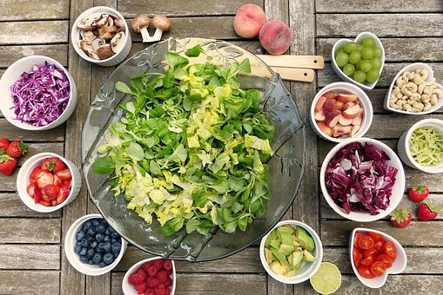
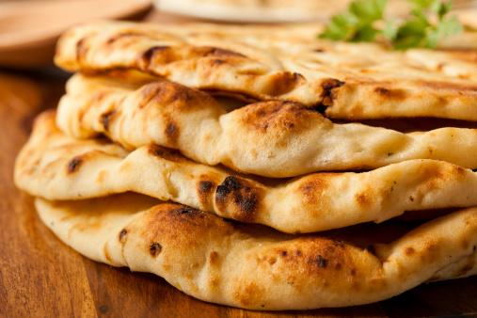
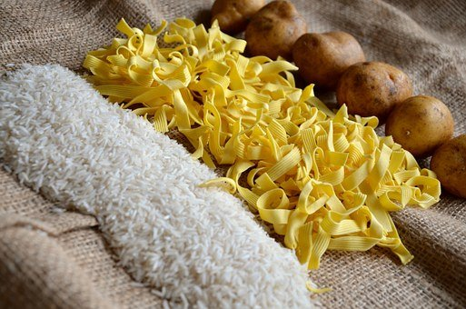
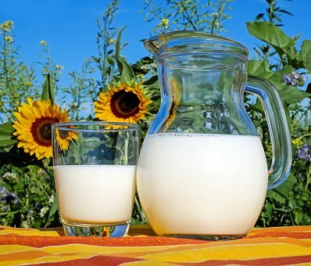
Carbohydrates (Carbs)
Carbohydrates are the body’s main source of energy
They are the starches, fibre, and sugars that are found inside of:
Fruits
Vegetables
Grains
Some carbohydrates and provide our bodies with energy as well the fibre that helps our digestion.
Eg: Whole Grains
Some carbohydrates provide us with macronutrients in addition to energy.
Eg: Vegetables and Fruits
Some carbohydrates provide us with a quick source of energy.
Eg: Sugar or refined grains
Notes:
The teacher can ask the students to look in the classroom or at home to find examples of carbohydrates. Students can take pictures of the carbohydrates they find, or they can write them down in a list.
(Szalay, 2017)

Slide 7
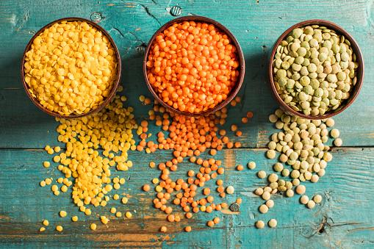
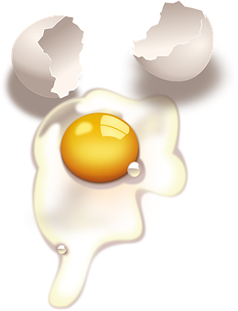
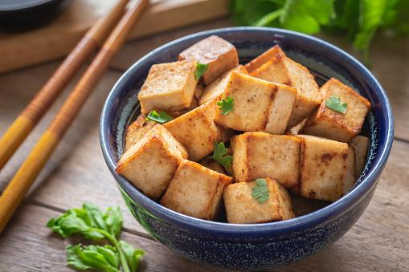
Proteins
The main role of protein in our body is to:
Repair our tissues
Help with tissue growth
Examples of foods that contain lots of protein include:
Beans, peas, and legumes
Nuts and seeds
Eggs/ milk products
Lean Meat
Tofu
Did You Know?
Protein can come from plants or animals!
Notes:
The teacher can ask the students to look in the classroom or at home to find examples of proteins. Students can take pictures of the proteins they find, or they can write them down in a list
(DK, 2017)

Slide 8
Fats
Fats are important for our body because:
They give us energy
They help us feel full and satisfied after eating
They can help protect our organs
They help our body to use certain vitamins and minerals
Notes:
The teacher can ask the students to look in the classroom or at home to find examples of fats. Students can take pictures of the fats they find, or they can write them down in a list
(KidsHealth, 2021)

Slide 9
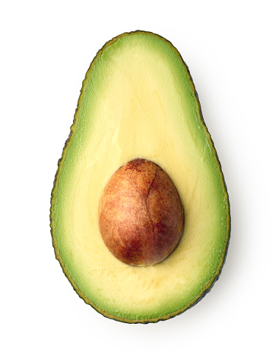
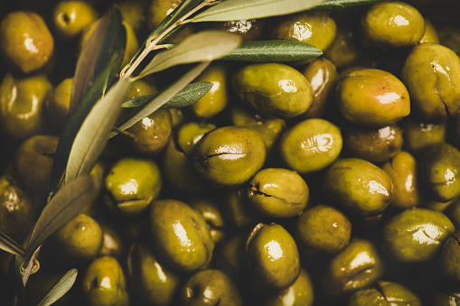
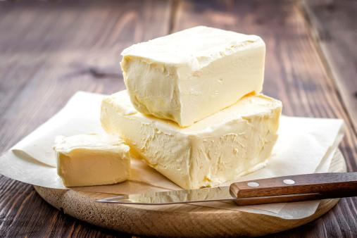
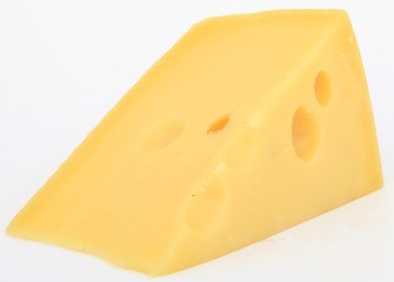
Three Different Types of Fats
Unsaturated fats
There are benefits to eating unsaturated fats
They are good for our heart
Examples: plants, fish, avocados, olives, walnuts
Saturated fats
This type of fat adds flavour to our foods, but our bodies don’t need it in large quantities.
Examples: meats, cheese, butter
Trans fats
These types of fats were once common in many types of processed foods, but manufacturers have switched to alternatives.
Notes:
(KidsHealth, 2021)

Slide 10
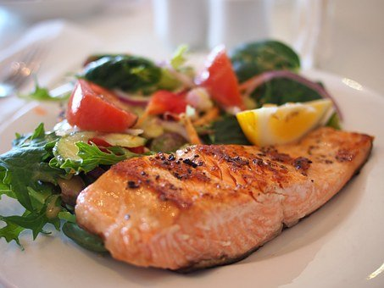
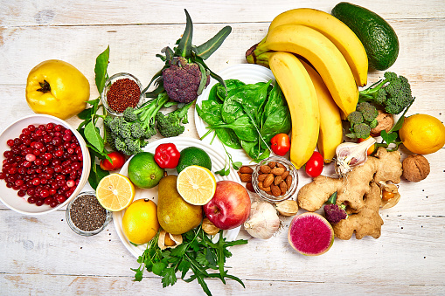
Vitamins
Some reasons why vitamins are important for our body:
They help our body grow
They help boost your immune system
They help cells and organs in your body function properly
We can get vitamins from eating plants or animals
Some vitamins are fat-soluble vitamins, while others are water-soluble vitamins
Notes:
(KidsHealth, 2021)

Slide 11
Minerals
Some reasons why minerals are important for our body:
They help our body grow and develop
They help our body stay healthy
They can help build strong bones
They can help our nervous system
Minerals come from the soil or water food is grown in.
They are absorbed by plants or are eaten by animals.
Notes:
(KidsHealth, 2021)

Slide 12
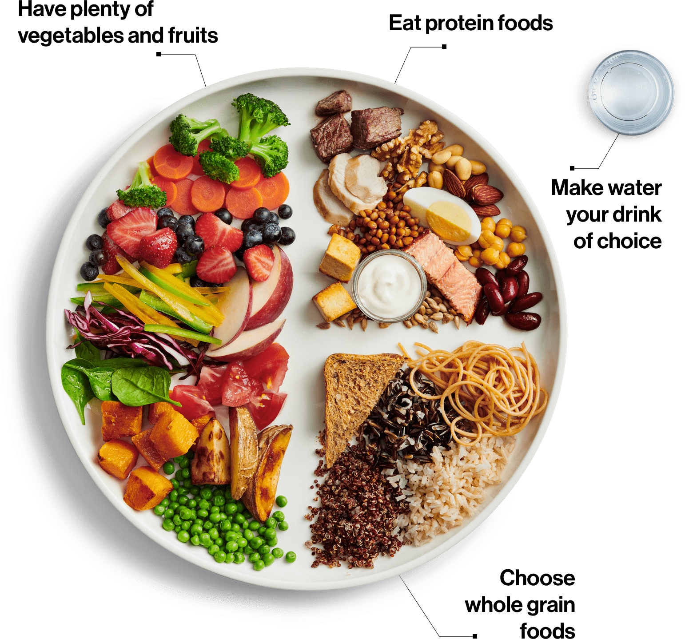
Canada’s Food Guide to Healthy Eating
Notes:
To encourage communication, the teacher can ask students who feel comfortable to verbally identify some of the foods they see on this plate.
(Government of Canada, 2019)

Slide 13
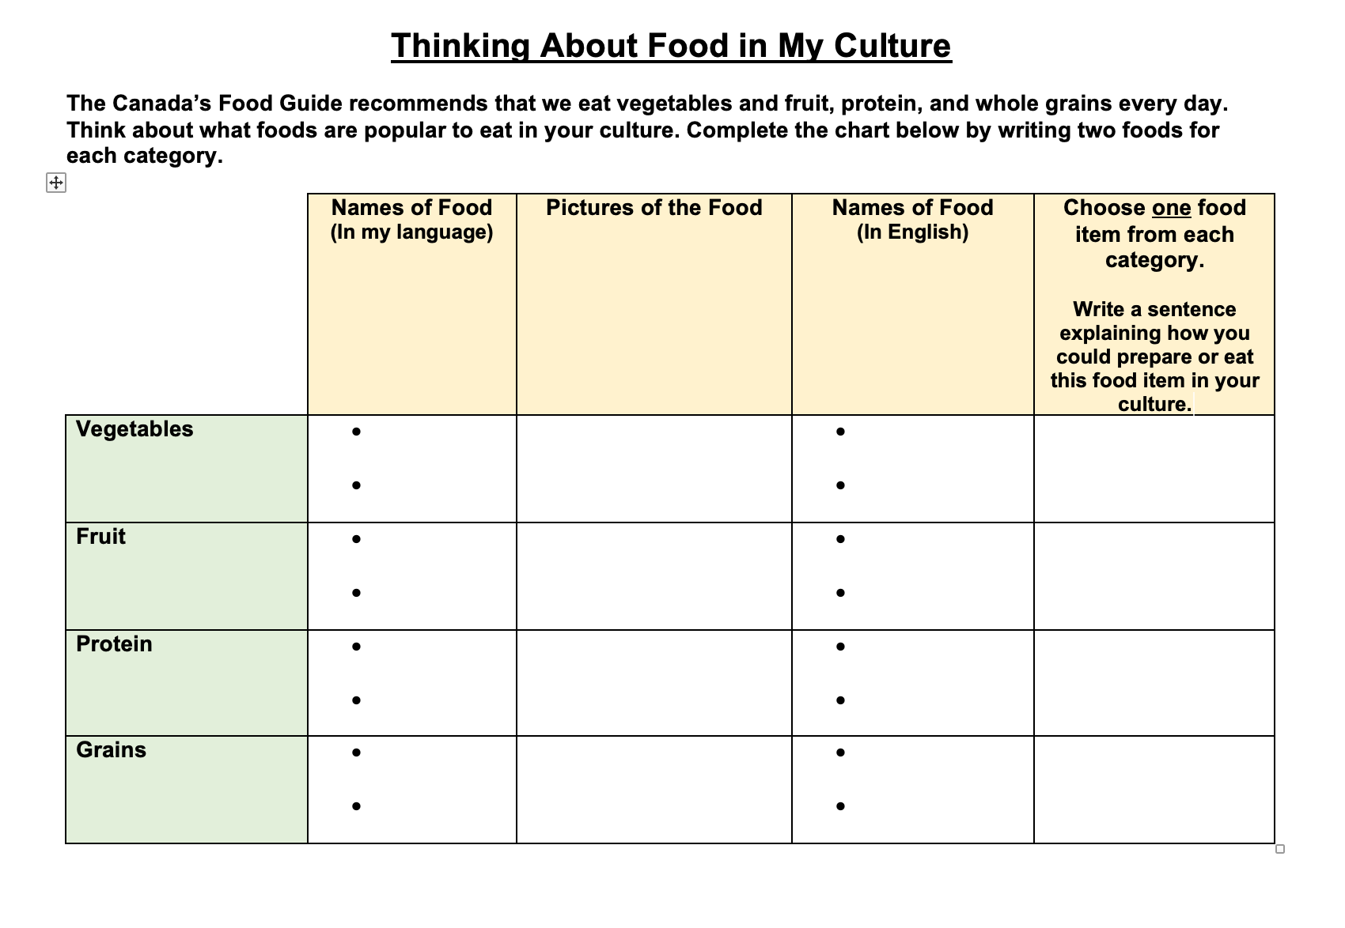
What are some foods that are popular in your culture?
Look at your worksheet “Thinking About Food in my Culture”

Slide 14
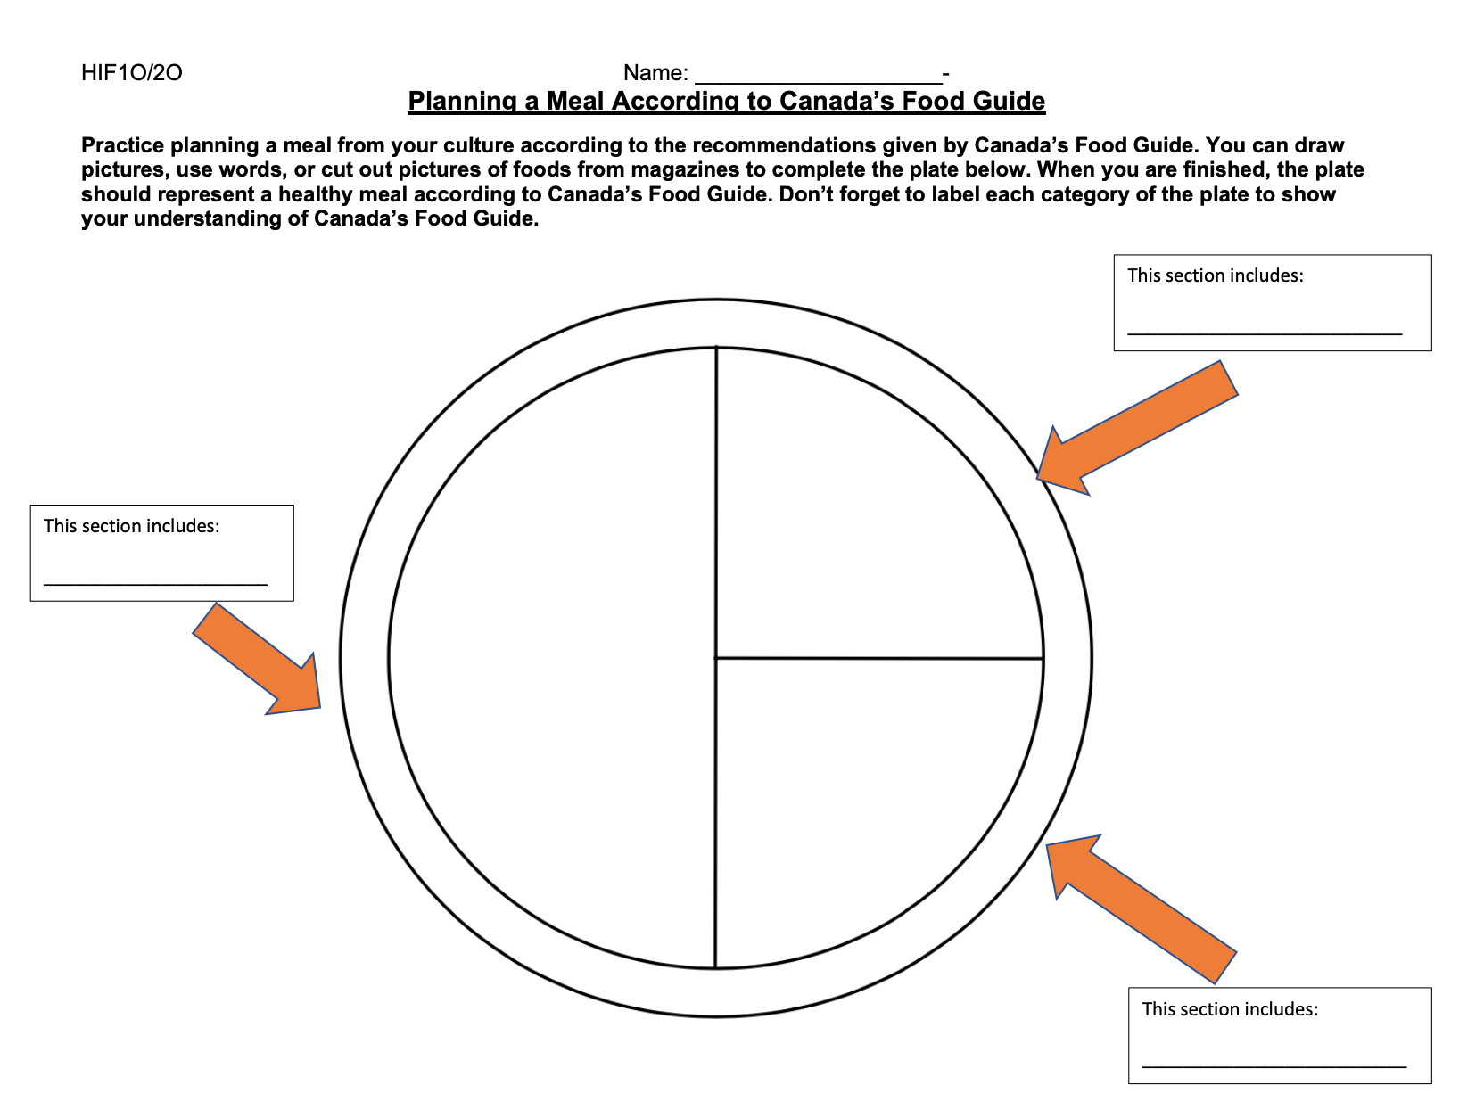
Please open the Google Jamboard your teacher shared with you.

Slide 15
THANKS!
Please keep this slide for attribution

