Slide 1
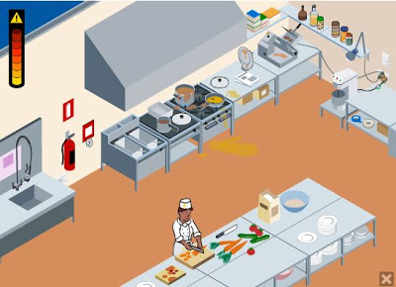
Kitchen Safety
HFN2O/ELL
Notes:
Teacher’s Notes: Try to enunciate as much as possible for ELLs. Read slowly and check often for understanding. If required, pause lesson for mini-explanations, examples, and/or clarification.

Slide 2
Introduction to Kitchen Safety:
What steps do we need to take in order to make sure we are preparing food and using the kitchen in a safe way?
CLASS DISCUSSION…….

Slide 3
*Word Wall *
In next slides, if you see a word that is underlined add it to your word wall sheet

Slide 4
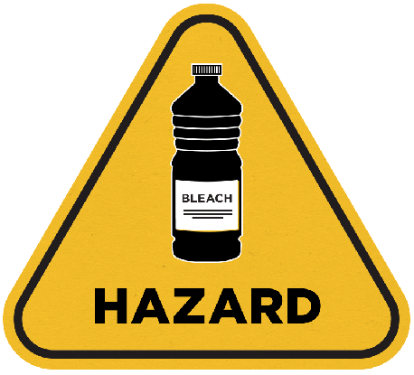
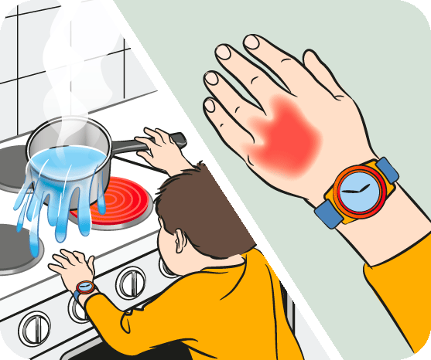
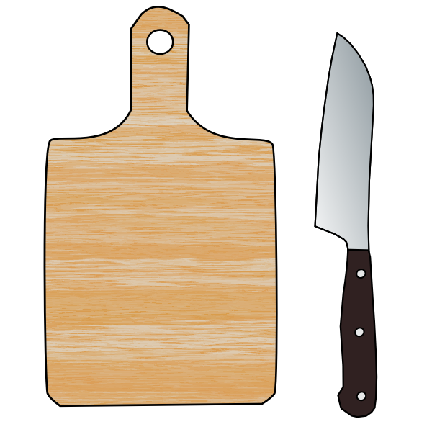
6 Areas of Safety Awareness in the Kitchen While cooking in the kitchen it is important to be aware of the space and to keep it clean. We will be discussing some common kitchen accidents and how to prevent them.
1. Electricity | 2. Chemicals | 3. Fires | 4. Burns | 5. Cuts | 6. Falls
Notes:
The Australian Raising Children Website (2020). Burn Image. https://raisingchildren.net.au/

Slide 5
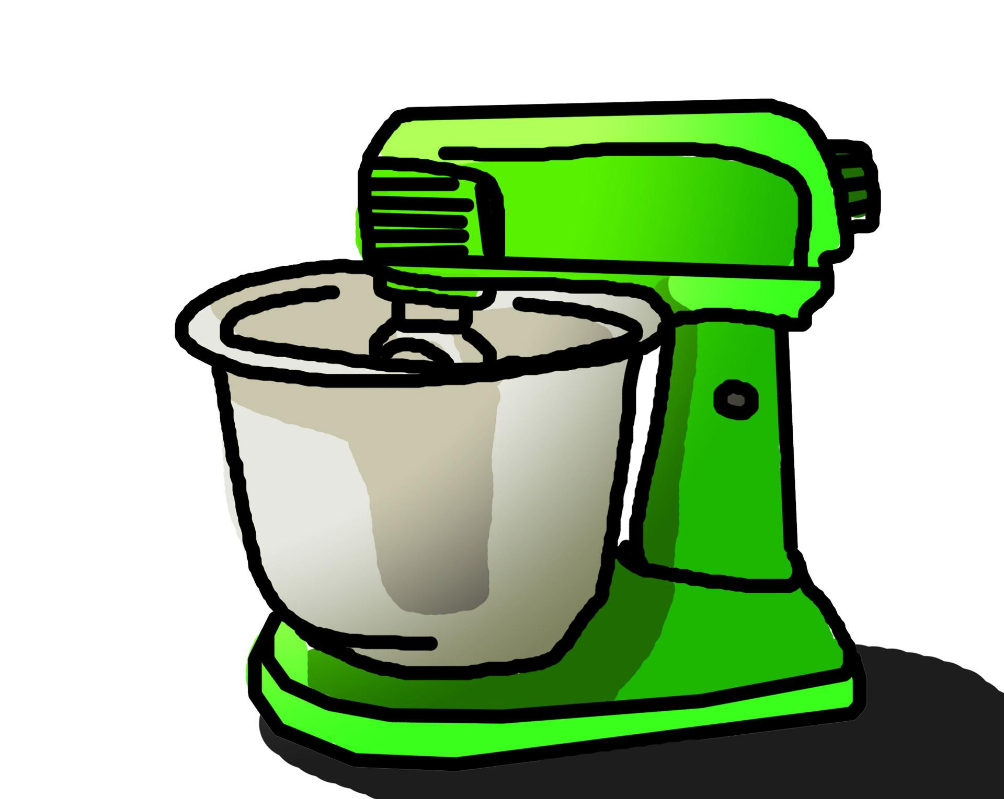
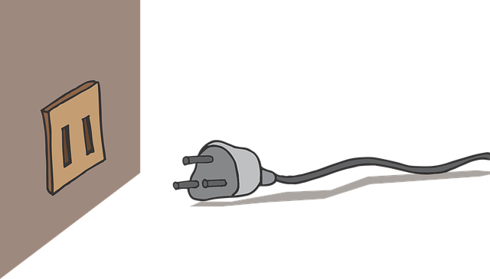
1. Electricity
Electrocution (i·lek·truh·kyoo·shn)
- Make sure hands and floor are dry when using appliances.
- Keep appliances and cords away from water.
- Avoid damage to electrical cords.
- Use outlets properly – avoid extension cords.
NEVER put fingers or kitchen tools inside an appliance that’s
plugged in.
- Turn off small appliances as soon as you're done with them.
- Don't put anything with metal in the microwave.

Slide 6
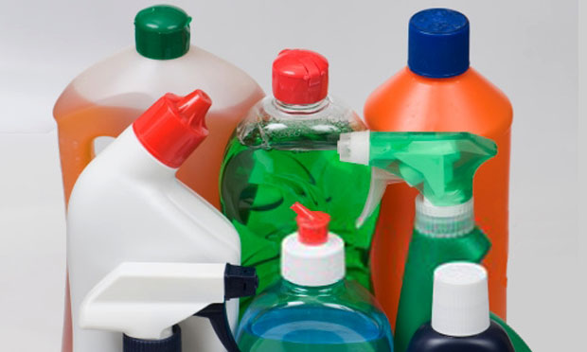
2. Chemicals (chem·i·cal)
- NEVER transfer chemicals to another container.
NEVER mix different chemicals.
Store chemicals away from food, pets and children.
Substitute for natural cleaners when possible.
(e.g. vinegar, baking soda, lemon juice etc.)

Slide 7
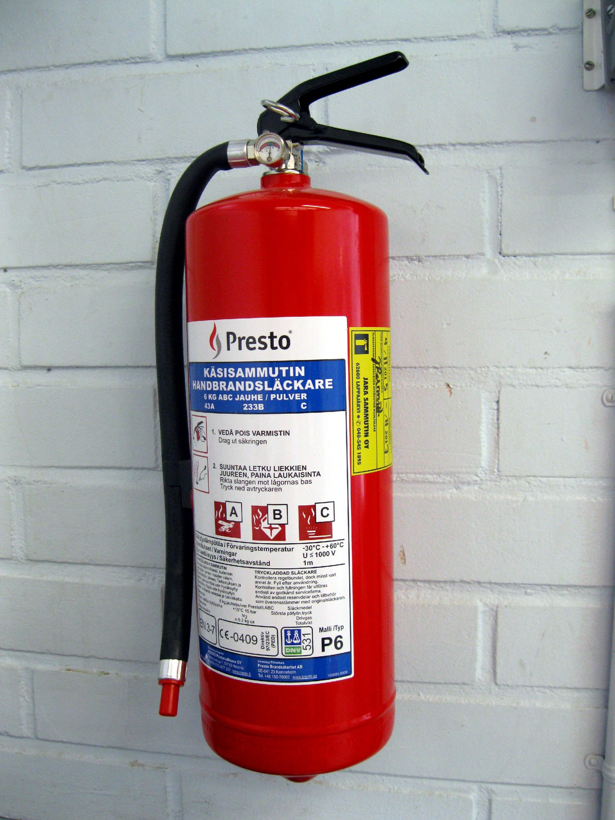
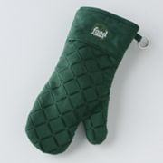
3. Fires (Part A)
Preventing Fires:
Use oven mitts – not kitchen towels to remove hot items
from the stove or oven
Keep flammable items, such as kitchen towels, paper towel,
recipes etc. away from the stove.
Remember to turn the oven and stove off when finished!
Keep a fire extinguisher close by – opposite your stove.

Slide 8
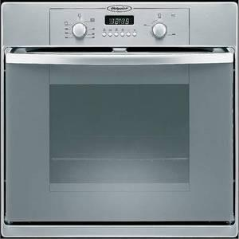
4. Fires (Part B) What to do if there is a fire: - NEVER attempt to carry a pan with burning contents. - Can use a dry chemical fire extinguisher. For containable fires… - If fire is on the stove top or electric skillet: -Turn off heat. -Put a cover on the pan and leave it on OR pour salt or baking soda on the flames. -DO NOT POUR WATER ON A GREASE FIRE! -DO NOT POUR flour or baking powder either – these will all make the fire worse. - Oven, microwave or toaster oven fire: Turn off or disconnect appliance; keep oven
door closed until the fire goes out.

Slide 9
5. Burns (Part A)
How to prevent?
Use oven mitts when picking up or uncovering hot pots and pans
Remove pot lids by lifting up the far edge of the cover first,
so steam will flow away from you
Keep pot handles turned towards the back or middle of the
stove.
Arrange oven racks properly before turning the oven on.
Stand to the side when you open the oven door.
Don't reach in a hot oven; pull rack out first.

Slide 10
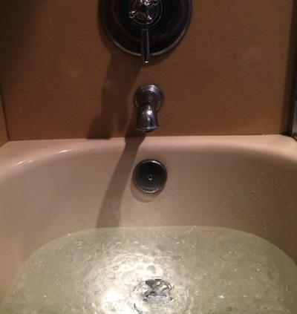
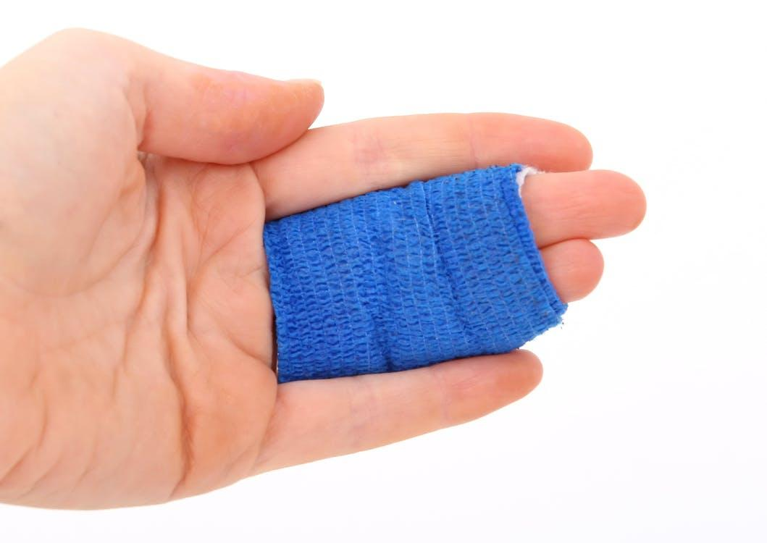
5. Burns (Part B)
What to do if you get one?
Soak burn in cold water for at least 5 minutes.
Treat with skin care product for burns.
Wrap burn loosely with gauze bandage.
Do not break blisters if they occur.
Do not put butter, oil or ice on burns.
Seek medical attention immediately for serious burns.

Slide 11
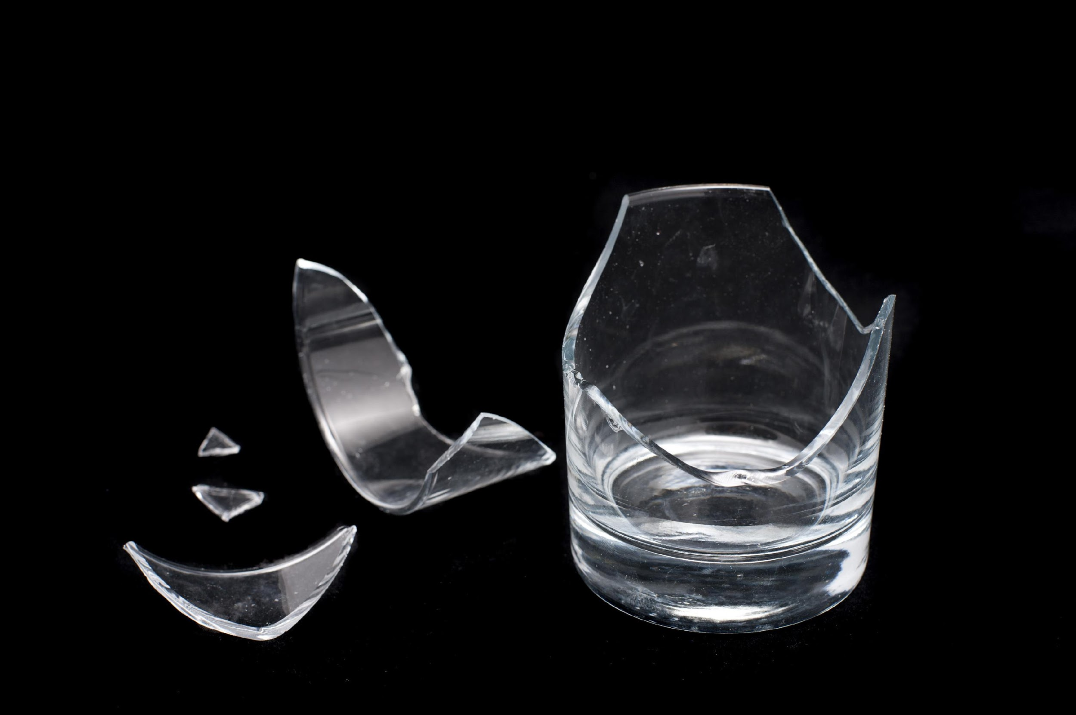
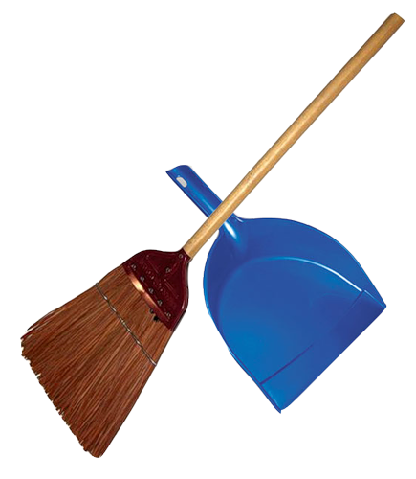
5. Cuts (Part A)
How to prevent?
Keep knives sharp and use properly.
Store knives in safe place.
Don't catch a falling knife.
Sweep up broken glass.
Don't soak knife or other sharp utensils in sink.
Wash knives immediately after use and return to
knife drawer/container.

Slide 12
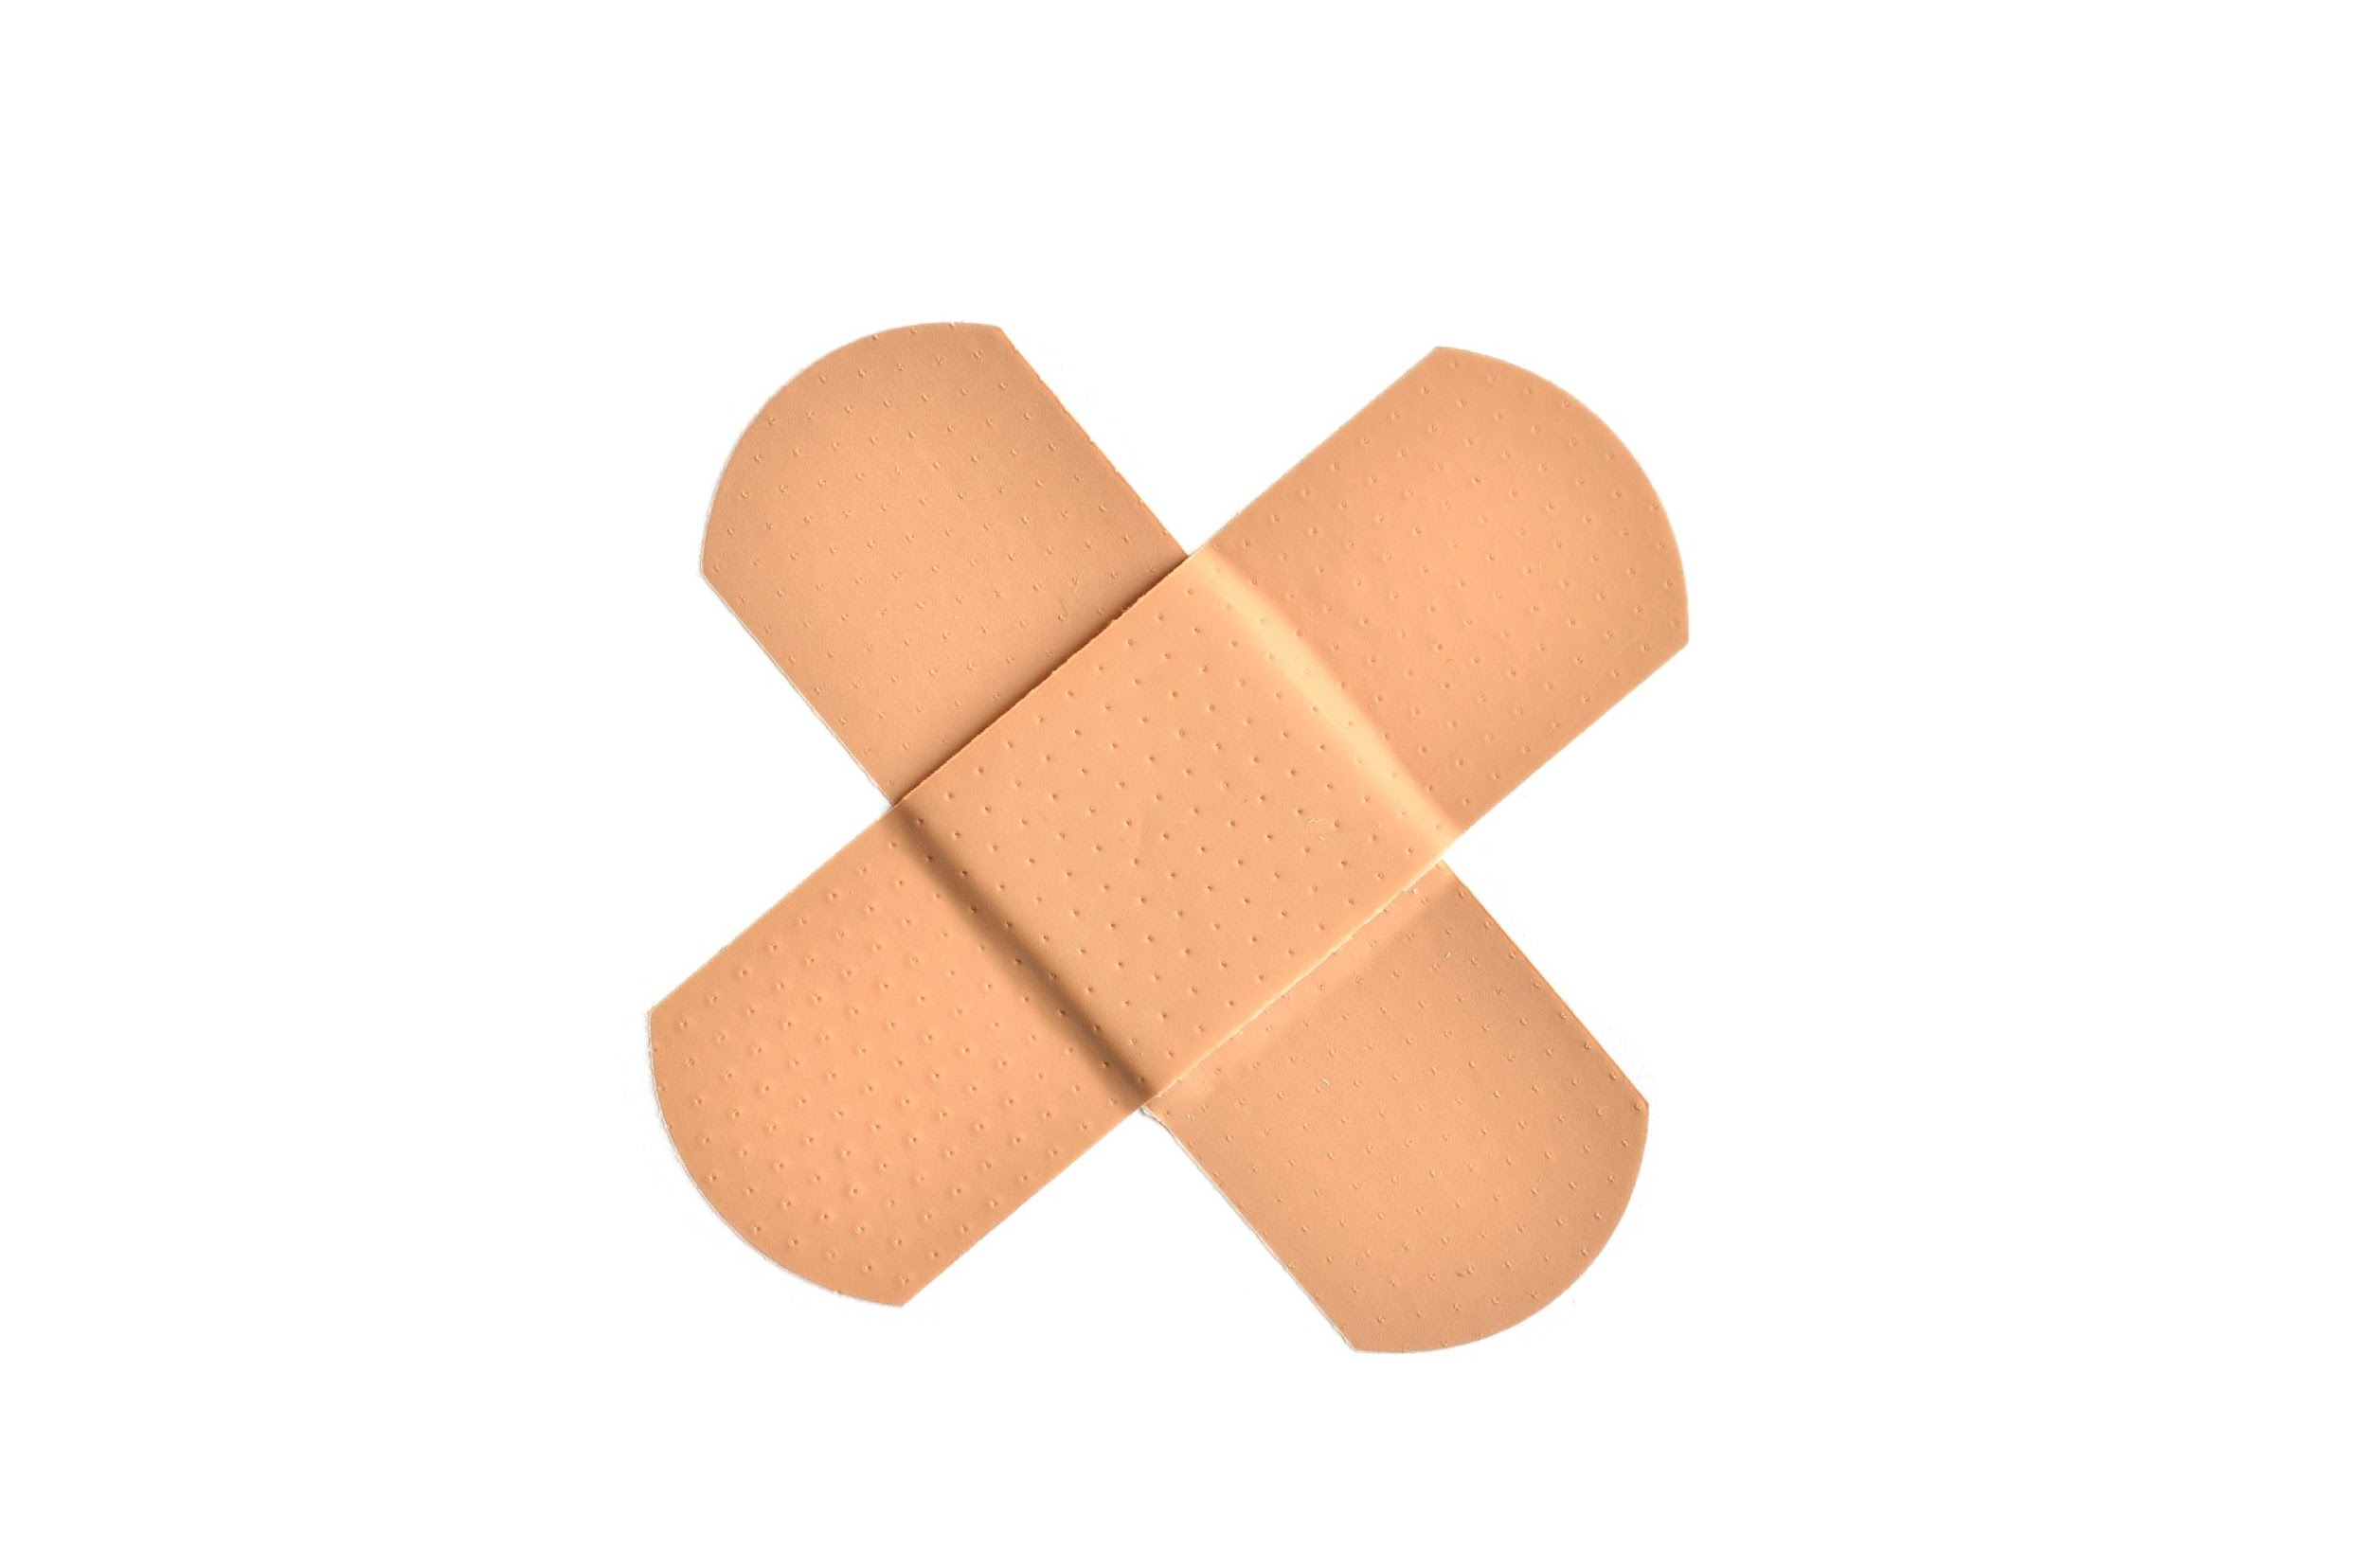
5. Cuts (Part B)
What to do if you get one?
Wash cut area with cool water and soap.
Apply pressure to cut to stop bleeding.
Cover wound with loose gauze or band-aid.
if it is in an area that could get dirty easily.
Can use an antibiotic ointment to speed healing and reduce
risk of infection.
Seek immediate medical attention for more serious cuts

Slide 13
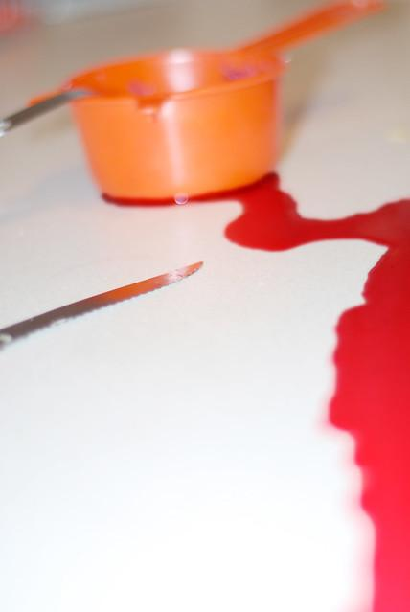
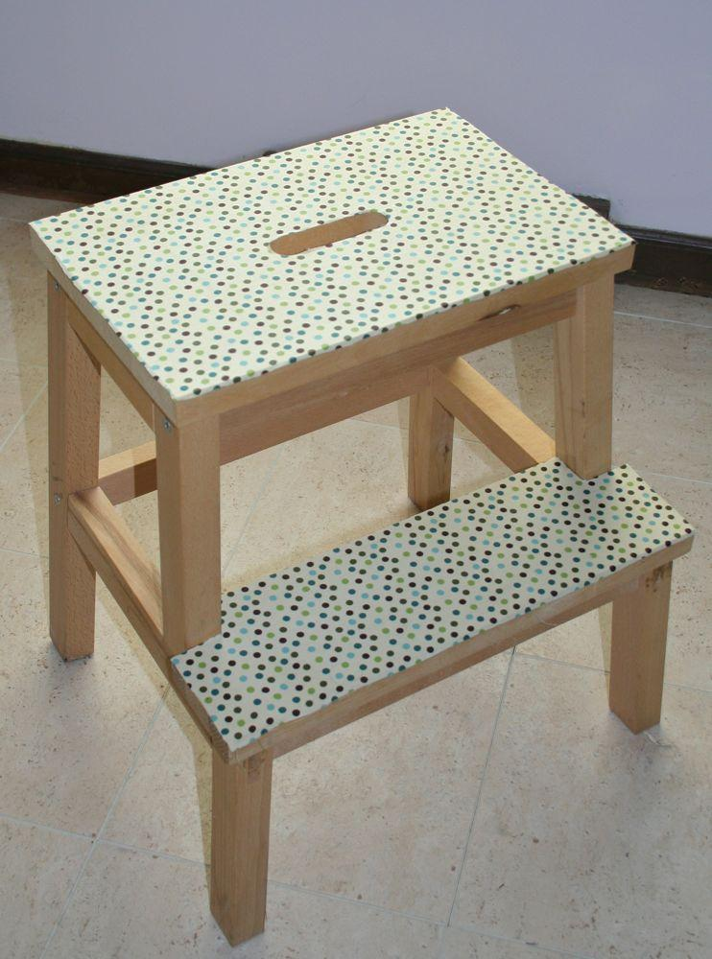
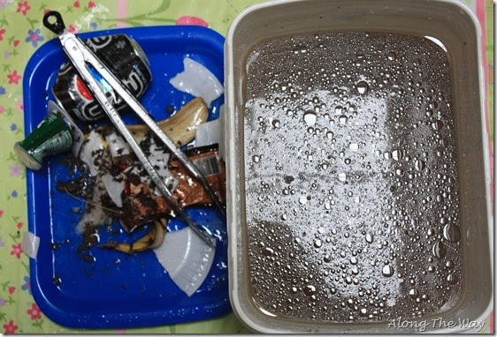
6. Falls (Part A)
How to prevent?
Keep floor clean, clear of clutter.
Wipe up spills.
Don't wear untied shoes, floppy slippers, long clothing etc.
Use steady step-stool for reaching high items.

Slide 14
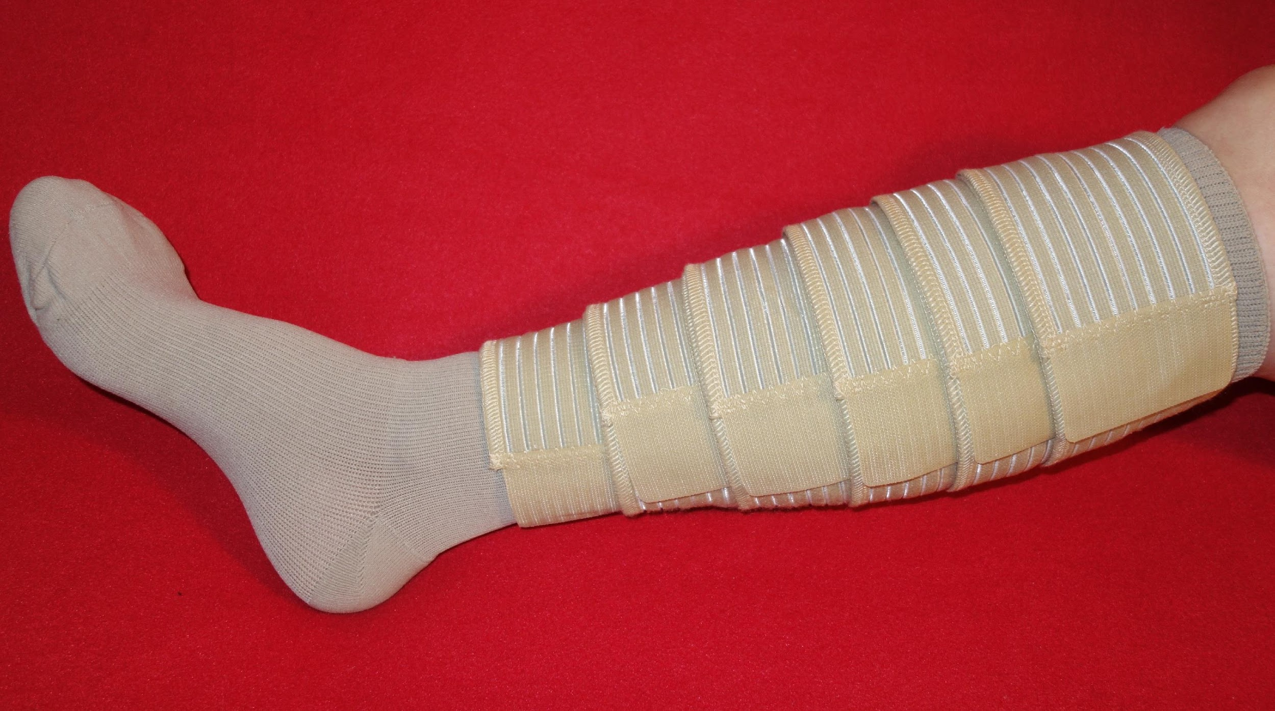
6. Falls (Part B)
What to do if you fall?
DO NOT MOVE if fall is major
(e.g. involving head, neck, spinal cord, loss of consciousness,
difficulty breathing etc.) – call 911 to seek medical attention
Immediately.
If fall is minor, apply ice to bruised areas and treat cuts
and scrapes.
Rest and monitor symptoms.
Notes:
As teacher follow your Board’s protocol

Slide 15
Vocabulary Chart
Example:
Word | Definition | Example: (Use this word in a sentence)
utensils | used to eat food with such as forks, knives, spoons, chopsticks, etc. | Place used eating utensils in the sink or in the dishwasher.

Slide 16
Kitchen Safety Chart
Example:
Kitchen Safety | Definition | Example: What to do if you have this kitchen safety accident?
Burns | -Use oven mitts when picking up or uncovering hot pots and pans. -Remove pot lids by lifting up the far edge of the cover first, so steam will flow away from you. -Keep pot handles turned towards the back or middle of the stove. -Arrange oven racks properly before turning the oven on Stand to the side when you open the oven door Don't reach in a hot oven; pull rack out first | -Soak burn in cool water for at least 5 minutes -Treat with skin care product for burns -Wrap burn loosely with gauze bandage -Do not break blisters if they occur -Do not put butter, oil or ice on burns -Seek medical attention immediately for serious burns

Slide 17
At Home Activity
Kitchen Safety Audit Card
KITCHEN SAFETY AT HOME | always | some-times | never | EXAMPLES
A. Electrocution
1.
2.
B. Hazardous Chemicals
1.
2.
C. Preventing Fires
1.
2.
D. Preventing Burns
1.
2.
E. Preventing Cuts
1.
2.
F. Preventing Falls
1.
2.

Slide 18
Questions?

