Slide 1
Knife Safety HFN2O/ELL
Notes:
Teacher’s Notes: Try to enunciate as much as possible for ELLs. Read slowly and check often for understanding. If required, pause lesson for mini-explanations, examples, and/or clarification.

Slide 2
Introduction to Knife Safety:
What steps do we need to take in order to make sure we are using knives safely in the kitchen and when we prepare food?
CLASS DISCUSSION…….

Slide 3
*Word Wall *
In next slides, if you see a word that is underlined add it to your word wall sheet

Slide 4
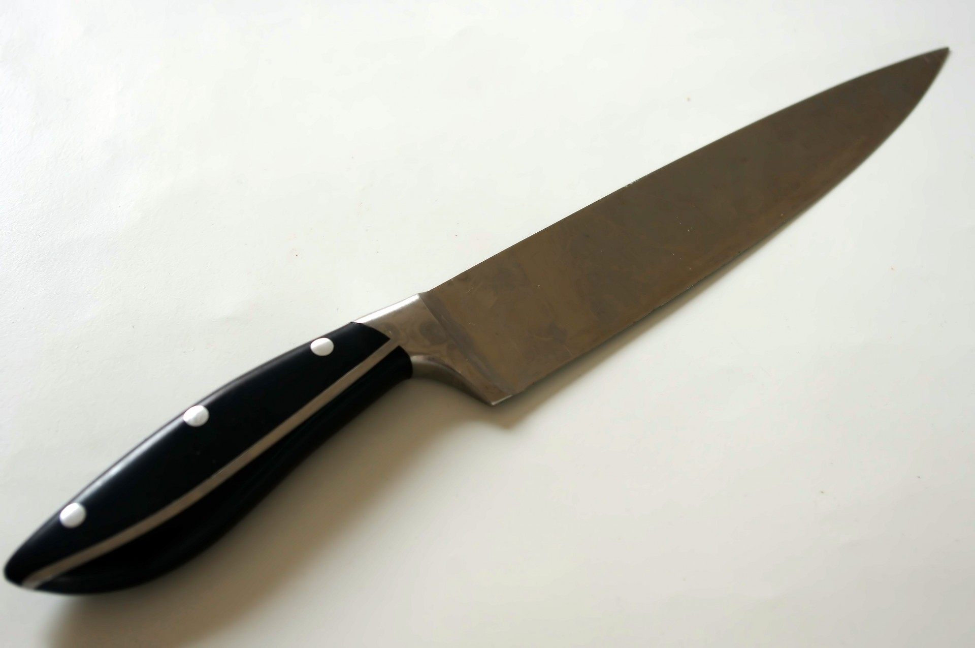
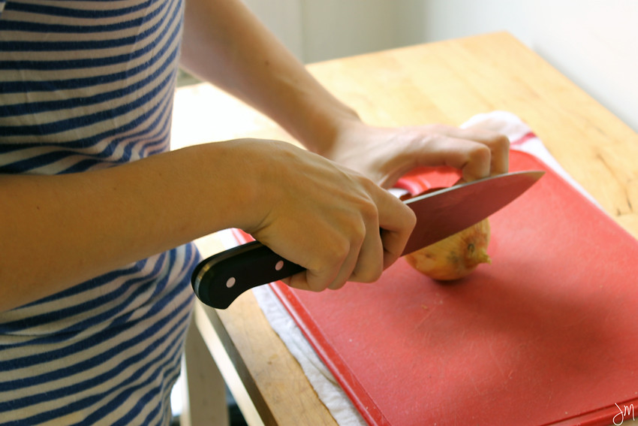
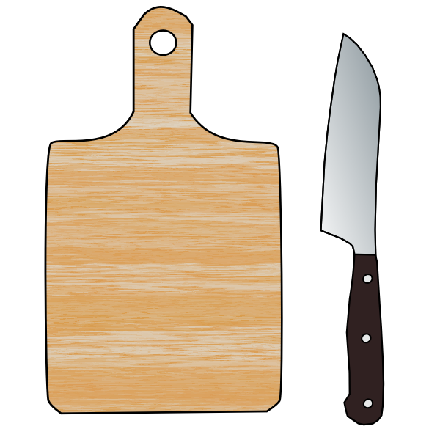
The Rules of Safe Knife Handling 1. Always walk with the knife pointed down and away from you and others. 2. Never cut with your fingers pointing outward, curl them under while holding the food. 3. Always use a cutting board. 4. Keep your knives sharp. 5. Cut with the blade facing away from your body.

Slide 5
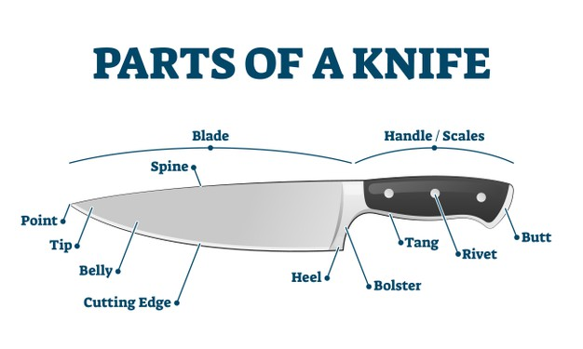
Parts of a Knife

Slide 6
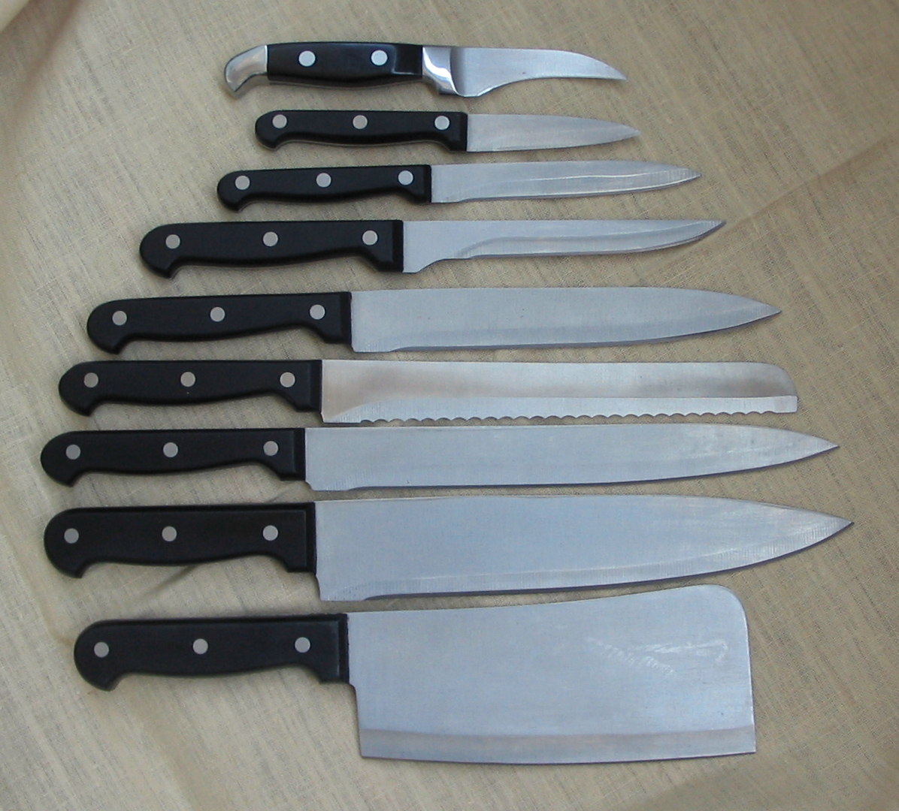
Types of Knives
CHEF’S KNIFE Used for cutting smaller items, such as tomatoes & apples.
SLICING KNIFE Used to cut a thin layer of peel off fruits and vegetables.
UTILITY KNIFE Ideal for slicing, chopping and dicing.
PARING KNIFE Used for removing bones from meat, poultry and fish.
BONING KNIFE Used for slicing large foods, such as meat and poultry.
BREAD KNIFE Serrated blade is ideal for slicing bread.

Slide 7
Cutting Terms and Techniques
SLICE To cut food into small, squared pieces.
PARE To make shallow, straight cuts into the surface of a food.
GRATE To cut food into large thin pieces.
CUBE/DICE To cut food into very small irregular pieces.
MINCE To cut off a thin layer of peel.
JULIENNE To cut food into shreds or thin strips. ???
SCORE To make shallow cuts in the surface of a food to avoid food from curling while cooking or let a marinade absorb.

Slide 8
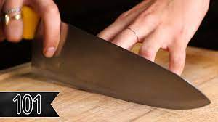
Knife Safety Video
Video: Tasty’s Basic Knife Skills
Notes:
Teacher’s notes: click on image for link / pause video to check for understanding and model techniques further
Video link: https://youtu.be/G-Fg7l7G1zw

Slide 9
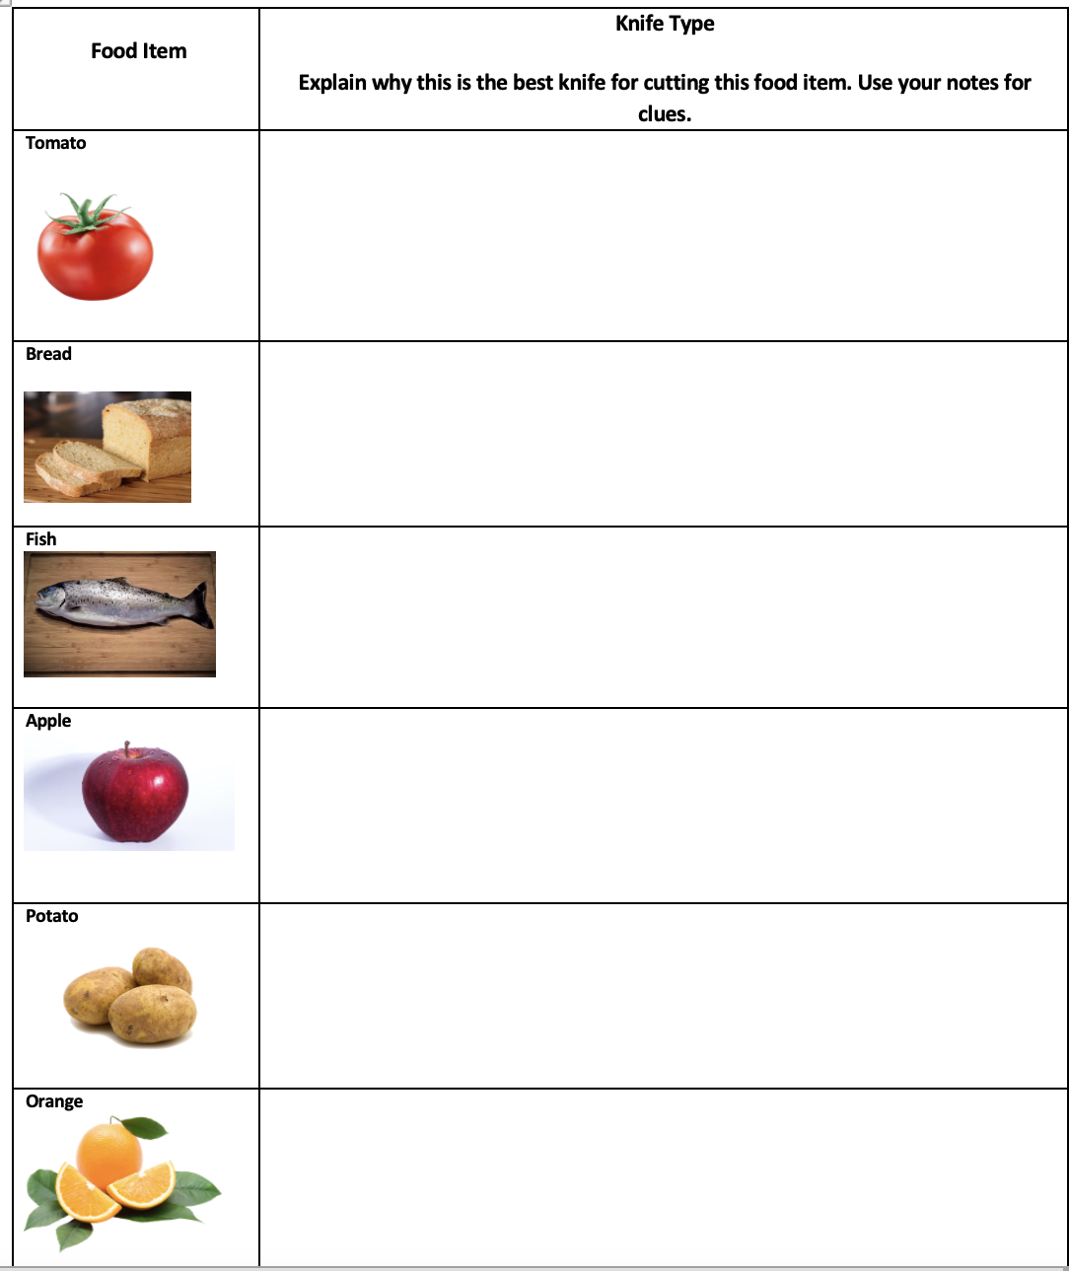
Knife Chart
Working in your cooking groups choose the appropriate knife for the food items listed below.
Notes:
Teacher’s notes: these are suggested, use food items appropriate/available within your program, playdoh is also a good substitute.

Slide 10
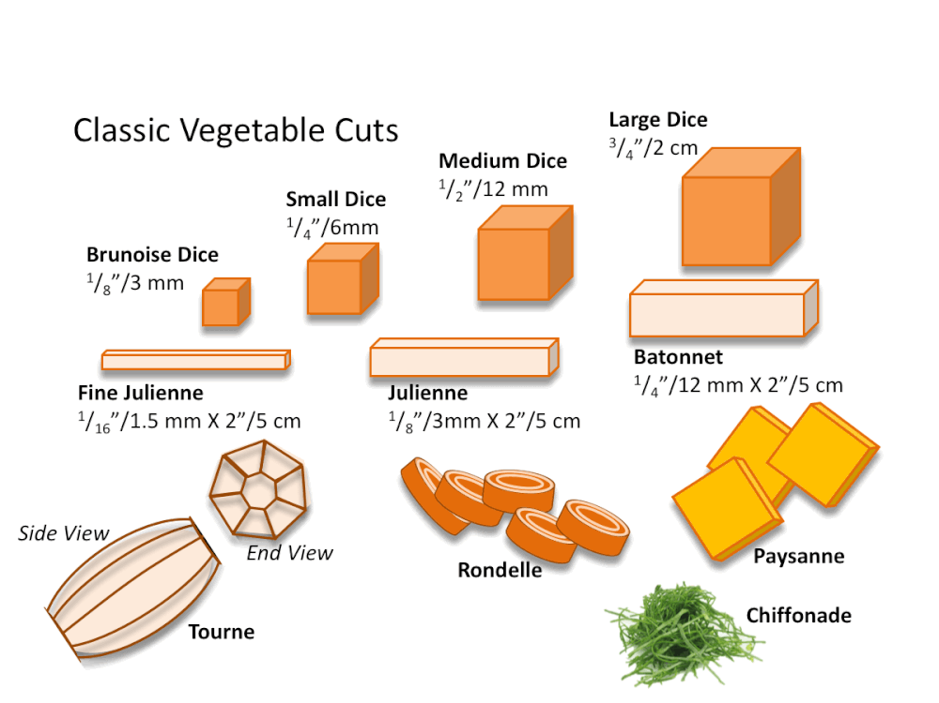
Mini Lab – Cutting Vegetables
Notes:
Image: Classic Vegetable Cuts : https://www.theculinarypro.com/knife-skills

Slide 11
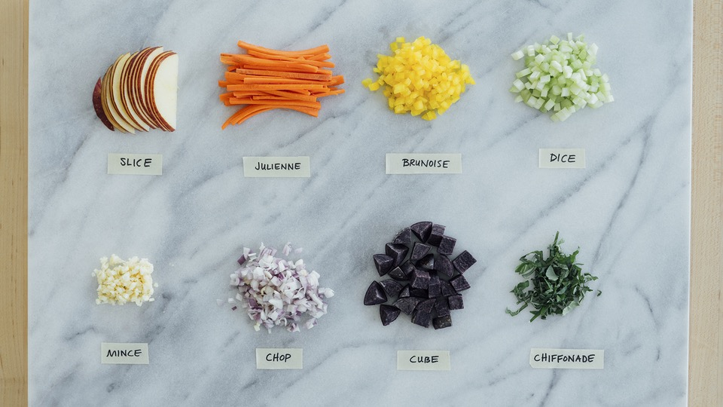
Mini Lab – Cutting Vegetables
Notes:
Teacher’s notes: remember to emphasize pronunciation, and make use of translations.
Image: What’s for dinner?: https://whatsfordinner.com/kitchen-tips/culinary-cutting-terms-images/

Slide 12
Vocabulary Chart
Example:
Word | Definition | Example: (Use this word in a sentence)
slice | To cut food into small, squared pieces. | I am eating a slice of watermelon.

Slide 13
Knife Chart
Example:
Food Item | Knife Type Explain why this is the best knife for cutting this food item. Use your notes for clues.
apple | Slicing knife – used to cut a thin layer of peel off fruits and vegetables.

Slide 14
Questions?

