Slide 1
Mending and Recycling fabric Heather Smith-Hudson

Slide 2
overview
Buying a quality garment and mending (sewing on new buttons or mending small holes) is better for the environment and your budget than replacing it [e.g. with a cheaply made fashionable garment (fast fashion)]

Slide 3
If Clothes are Torn or Worn
Mend them
Use the remaining material to make something new
Save the small material for scraps to use in sewing class!
Use them as rags for cleaning
Send them to a clothing recycling program
Do not throw them in the garbage!

Slide 4
Mending 1 - stitches
Learn to hand sew for beginners - https://youtu.be/Vva2h5oSYK8
includes threading a needle, knotting, using a thimble, pinning fabric, running stitch, whipstitch, ripping out stitches using a seam ripper, making a hem, how to sew on a button

Slide 5
Mending 2 - Stitches
Stitches and techniques for hand sewing - https://www.thesprucecrafts.com/learn-stitches-and-hand-sewing-projects-2978472
includes how to thread a needle, basting stitch (a wider version of running stitch), how to sew on a button

Slide 6
Mending 3 - stitches
5 Basic Stitches You Need to Know, Plus Other Textile Tips - https://makezine.com/2016/03/22/5-basic-stitches-you-need-know-plus-textile-tips/
includes cross-stitch, whipstitch, running stitch, ladder stitch, back stitch

Slide 7
Mending 4 – repairing a hole
How to: Clothing repairs: Repairing a Hole. https://www.youtube.com/watch?v=a-DApWLikWQ

Slide 8
Mending 5 - darning
How to repair a hole in a sock with darning - https://youtu.be/yi_J8YeQkww

Slide 9
Mending 6 - knotting
How to Tie a Basic Quilter's Knot - https://youtu.be/WjkaTppunEk

Slide 10
Mending 7 – sewing on buttons
How to Sew on a Button 1 – Video https://youtu.be/xNy9hLCl0NM
See “Five Steps to Sewing on a Button” handout

Slide 11
Mending - Handout
See Mending – Hand Stitching Handout
Check for Understanding – Which stitch is called basting stitch when the stitches are far apart?
Kahoot - Review - Basic Hand Sewing Stitches by FACS4LYFE

Slide 12
A New Way to ThINK!

Slide 13
Recycling Summary Activities 1
Read article(s) and write a summary article of 5 points:
Reduce, recycle, relieve the planet of its landfill burden this Earth Day. https://torontosun.com/life/fashion-beauty/0421-lifenational/wcm/52c14d44-dde3-49fb-90da-6bef55271997/amp/

Slide 14
Recycling Summary Activities 2
You Know Fast Fashion Is Bad For The Planet. So Why Can't You Stop Buying It? (Note Pictures) https://www.huffpost.com/entry/fast-fashion-bad-for-planet_l_607efb04e4b03c18bc2a12bd?fbclid=IwAR0s_rEb05xrhsdFnVJRxie5uwGl_apTkWSSyKU2BBit8yF_qZLCnXma-DU
Check for understanding – Add 1 word to describe “fast fashion” to the class Jamboard

Slide 15
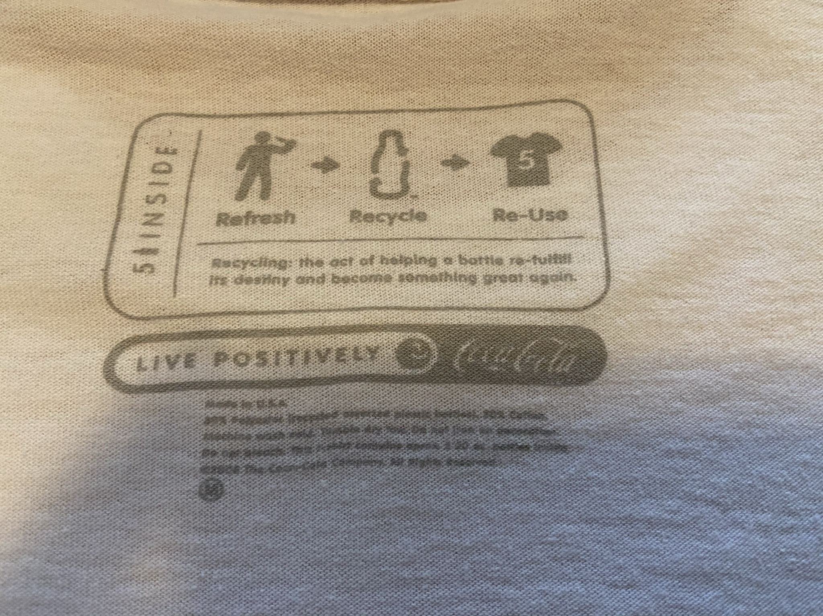
Coke shirt (partially) made from recycled bottles
Polyester/Cotton Blend
80% Cotton
20% Polyester from recycled Coke bottles

Slide 16
Clothing Recycling Programs/Brands
Bag2School North America. http://www.bag2schoolfundraising.com/bio (fundraising)
Scrap Monster. Textile Recycling Companies in Canada. https://www.scrapmonster.com/companies/textile-recycling/country/canada/13
Sustainable Jungle. 17 Fashion Brands For Recycled And Upcycled Clothing https://www.sustainablejungle.com/sustainable-fashion/recycled-upcycled-clothing/

