Slide 1
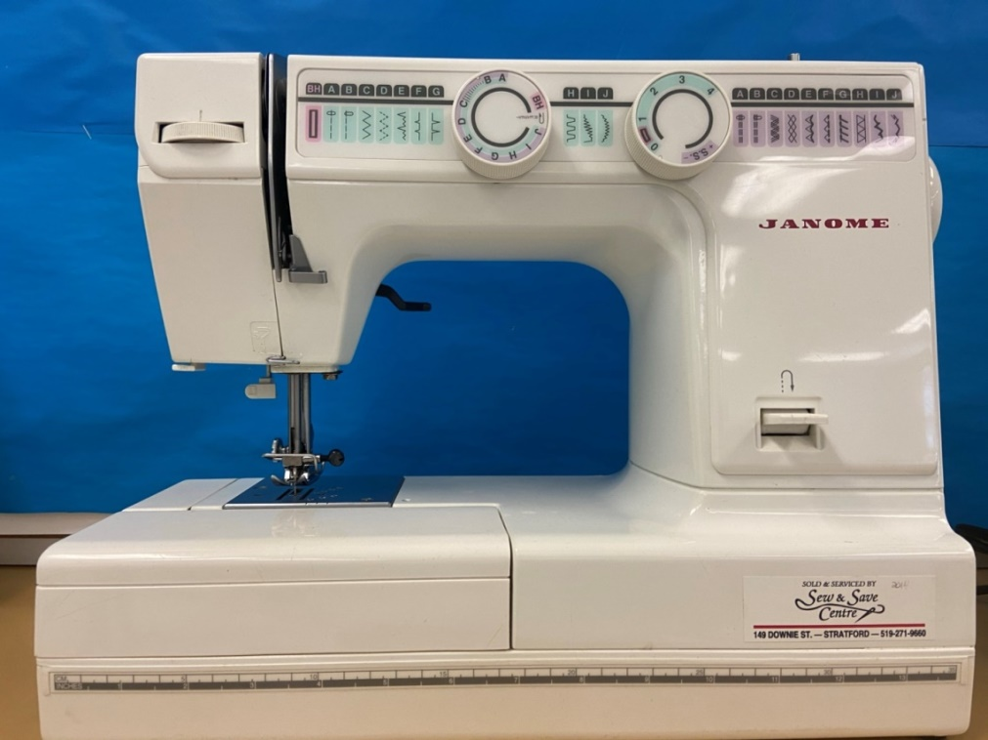
Safety in the Family Studies Sewing Lab

Slide 2
Safe Sewing for Beginners
Sewing Safety – Best Tips for Beginners - https://blog.treasurie.com/sewing-safety/
Look at all photos.

Slide 3
Safe Sewing for Beginners
How to Use a Sewing Machine for Beginners - https://youtu.be/iQ6a56EwuYw
Check for Understanding:
True/False – Cotton thread is used.
True/False – Stitch length should be 2.5 cm.

Slide 4
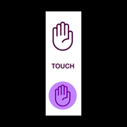
Safe Sewing for Beginners
Understanding the Basic Parts of a Sewing Machine - https://youtu.be/tzf4BZ7zNC0
Review: Now, you will place labels on your sewing machine.

Slide 5
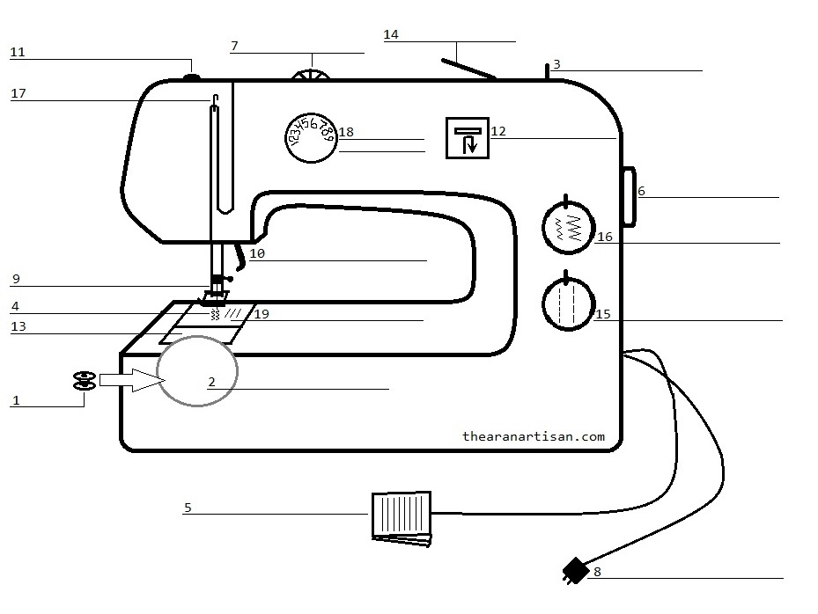
After you have placed labels on your sewing machine, then you will label your diagram handout.

Slide 6
Safe Sewing for Beginners
Back Stitch Reverse Stitch to Reinforce Sewing - https://youtu.be/HKpoqrllYPY
Check for Understanding:
Draw a picture of what the ‘reverse stitch’ symbol looks like.

Slide 7
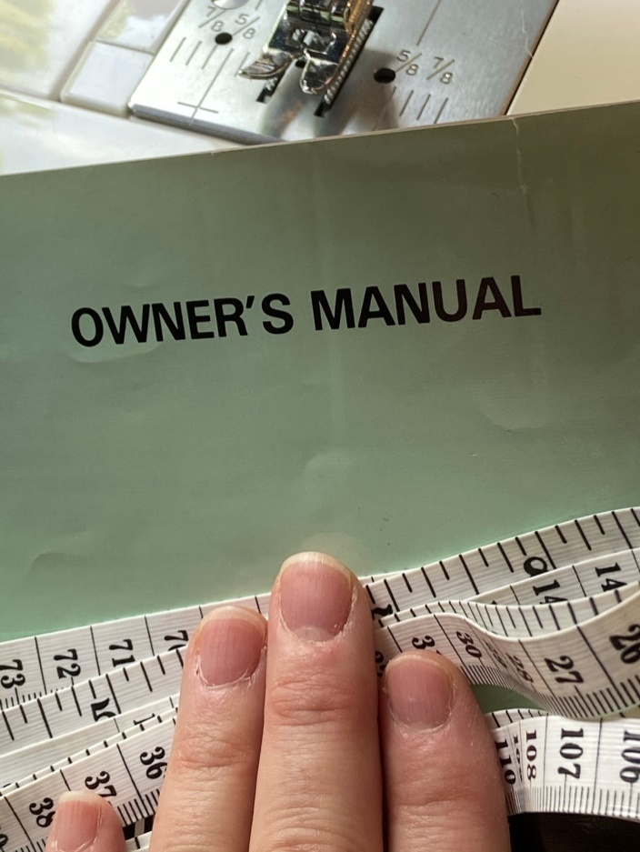
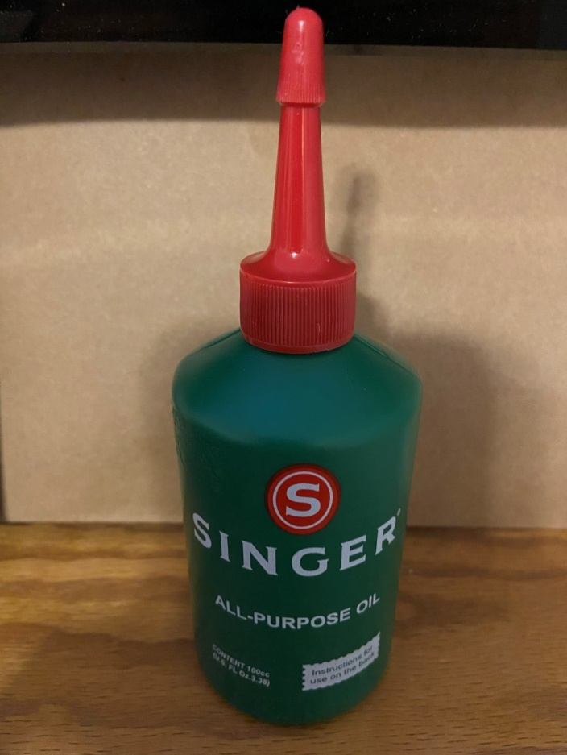
Sewing Machine Maintenance

Slide 8
Safety Rules
Family Studies Sewing Lab Safety Contract
Matching Game

Slide 9
Questions?

